Slide 1
CORC Impact & Learning
Miranda Wolpert
CORC Director

Slide 2
Plan
Advances in measuring outcomes- best approaches and measures
Effectiveness of services- using insights from CORC dataset
Thinking whole system- what CORC is doing to look at this

Slide 3
Go Vote
Go to www.govote.at
and use the code 28 57 92
Temperature check
Results

Slide 4
Measurement challenges
No consensus between respondents : children and parents (Yeh & Weisz, 2001).
Some measures less sensitive to change than others e.g. SDQ vs symptom specific (Lee et al 2005)
Some difficulties more stable than other e.g. behavioural difficulties (Scott et al 2001)
Challenge of finding appropriate comparison groups (Lambert 2011)

Slide 5
Implementation challenges
2005 National survey UK CAMHS service leads found < 30% implementing outcomes measures (N=186) (Johnson and Gowers 2005)
2011 N E Midlands 127 clinicians surveyed - 76% clinicians said they wanted more training on use of measures. (Batty et al., 2013)
67% of clinicians Sydney, Australia would be unwilling to implement outcome measures even if it improved patient care (Walter, Cleary, & Rey, 1998)
UK study clinicians and service users found concerns about use of measures (Moran et al 2011)
2011 N E Midlands random case note audit (61 cases) found only 6% cases with paired child or parent reported outcome measures (Batty et al., 2013)

Slide 6
Advances in measuring outcomes: Guidance
Notes:
Young service users and carers want their views considered in intervention decisions and therapy.
Young people can experience difficulties in getting their views across in a way that feels safe and respected.
Forms can help ensure that practitioners ask about the key aspects of the problem for young people and families and realise when someone is about to disengage from therapy.
Forms should support the voice of young people and families who use services as part of collaborative practice and shared decision-making.
Forms can become a barrier to conversations if not introduced and used in sensitive ways (see the dos and don’ts)
Remember you are trying to give a voice to young people and their parents accessing services:
Arrange the operational support
Have an away-day
Make some routine discussion time in team meetings - Ten minutes a week is all that is needed
Have a go!
Use your experts
Law, Jones and Wolpert 2015

Slide 7
Advances in measuring outcomes: academic publications
Personalised measurement (Jacob, J., Edbrooke-Childs, J., Law, D., & Wolpert, M. (2015). Measuring what matters to patients: Using goal content to inform measure choice and development. Clinical Child Psychology and Psychiatry, 1359104515615642.)
Idiographic and standardised measurement (Edbrooke‐Childs, J., Jacob, J., Law, D., Deighton, J., & Wolpert, M. (2015). Interpreting standardized and idiographic outcome measures in CAMHS: what does change mean and how does it relate to functioning and experience?. Child and Adolescent Mental Health, 20(3), 142-148.)
Goal themes (Jacob, J., Edbrooke-Childs, J., Holley, S., Law, D., & Wolpert, M. (2015). Horses for courses? A qualitative exploration of goals formulated in mental health settings by young people, parents, and clinicians. Clinical child psychology and psychiatry, 1359104515577487.)

Slide 8
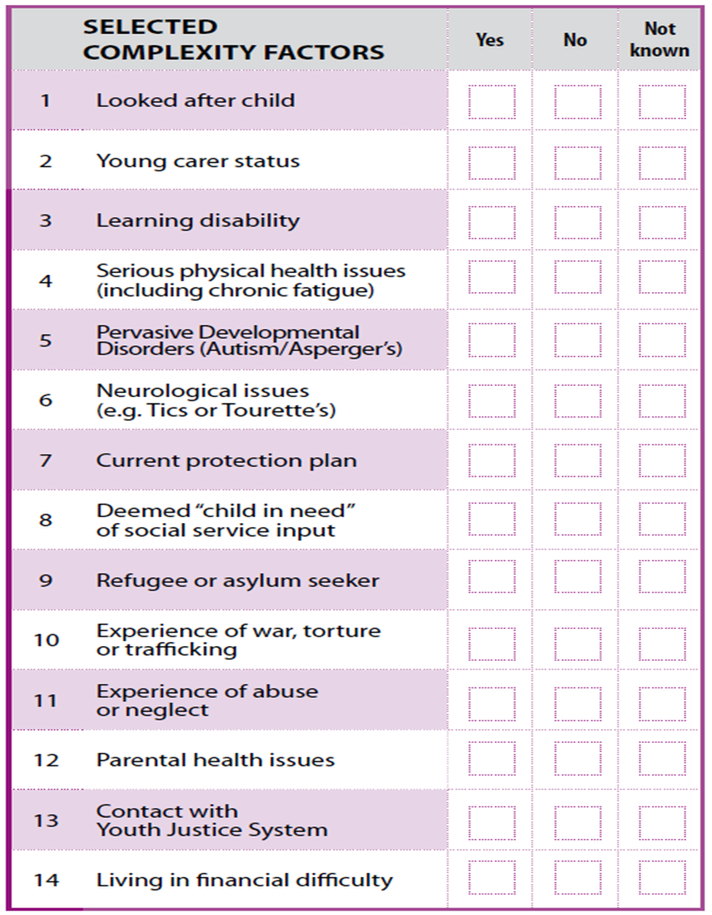
Advances in measuring outcomes: tools

Slide 9
Advances in Measuring outcomes:tools

Slide 10
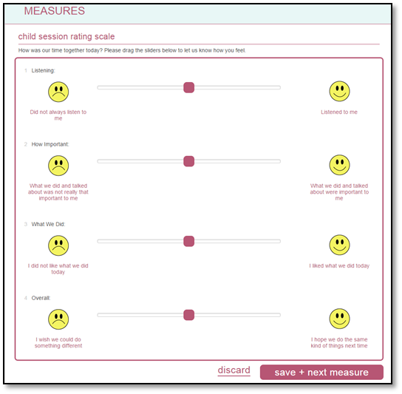
Advances in measuring outcomes: online

Slide 11
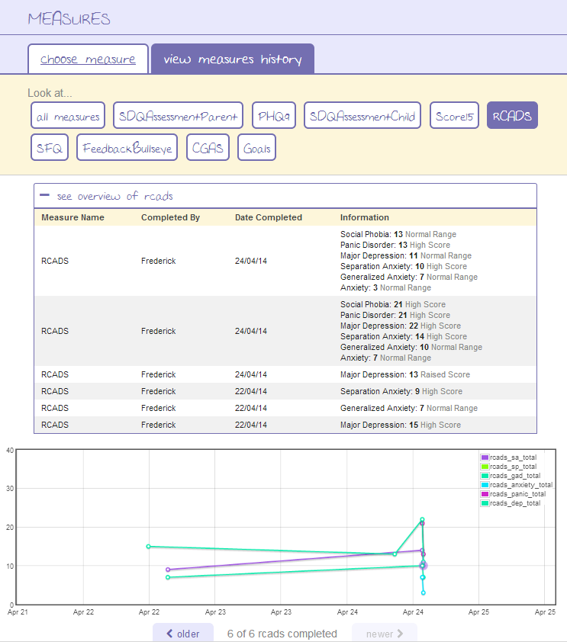
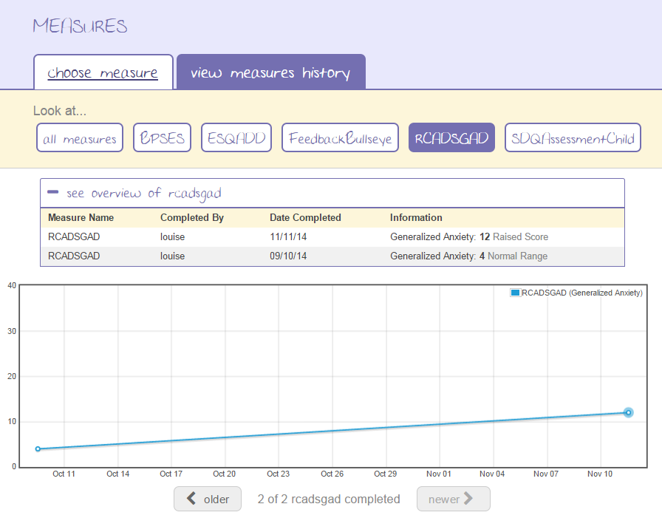

Slide 12
Effectiveness of services – considering > 400,000 children in CORC datasets
3 datasets; snapshot, corc +, CYP IAPT
Are child mental health services effective?
A. Do symptoms and wellbeing improve and does this vary according to demographic information (including complexity factors)?
B. Are interventions delivered as part of routine care as effective as when they are delivered as part of RCTs
C. How much variance can be accounted for at the therapist level?
D. How much variance can be accounted for at the service level?
Are child mental health services providing value for money?

Slide 13
What counts as a good outcome?
Movement towards goals
Recovery :movement to a score below caseness from a score of caseness or above.”
Reliable improvement : degree of score improvement on one measure not likely due to measurement error and the score for every other scale either did the same or did not reliably deteriorate
Considering outcomes relative “no treatment”
Added value score
Propensity score matching

Slide 14
Vote now on question 2
Go to www.govote.at
and use the code 28 57 92
Results

Slide 15
Analysis of movement toward achieving goals?
14% of closed cases had paired goal data (N= 3369)
Of these 86% showed movement towards goals
Mean change on goals was 3.8 (Time 1 mean = 3.0; Time 2 mean = 6.8)
Effect size = 1.66
Measure | % positive change | % negative change | % no change | Sample size
Goals Based Outcomes | 86% | 4% | 10% | 3369
Reduce/stop self-harm,
To be able to understand her feelings and fears,
To develop more self-confidence and self-belief, and strengthen his resilience to difficult . . . Situations (Jacobs et al 2015)
Notes:
Raw change = change of 1 point or more in either direction
No change = same score at first and last time points
*NB mean change 3.8 for GBO

Slide 16
Recovery and improvement
15% recovery
32% improvement
19% deterioration (Warren et al. 2010)

Slide 17
Advances in analysing outcomes
Propensity score matching
Considering service differences
Impact of therapist factors
Trajectory mapping

Slide 18
Advance in understanding what impacts on outcomes
Shared decision making (Edbrooke-Childs, J., Jacob, J., Argent, R., Patalay, P., Deighton, J., & Wolpert, M. (2015). The relationship between child-and parent-reported shared decision making and child-, parent-, and clinician-reported treatment outcome in routinely collected child mental health services data. Clinical child psychology and psychiatry, 1359104515591226.)
Evidence based practice (Deighton, J., Argent, R., De Francesco, D., Edbrooke-Childs, J., Jacob, J., Fleming, I., ... & Wolpert, M. (2015). Associations between evidence-based practice and mental health outcomes in child and adolescent mental health services. Clinical child psychology and psychiatry, 1359104515589637.)
Articles under review
Goals use and satisfaction
Case mix adjustment
Agreement across respondents
How outcome information can inform change (book chapter)

Slide 19
Thinking whole system

Slide 20
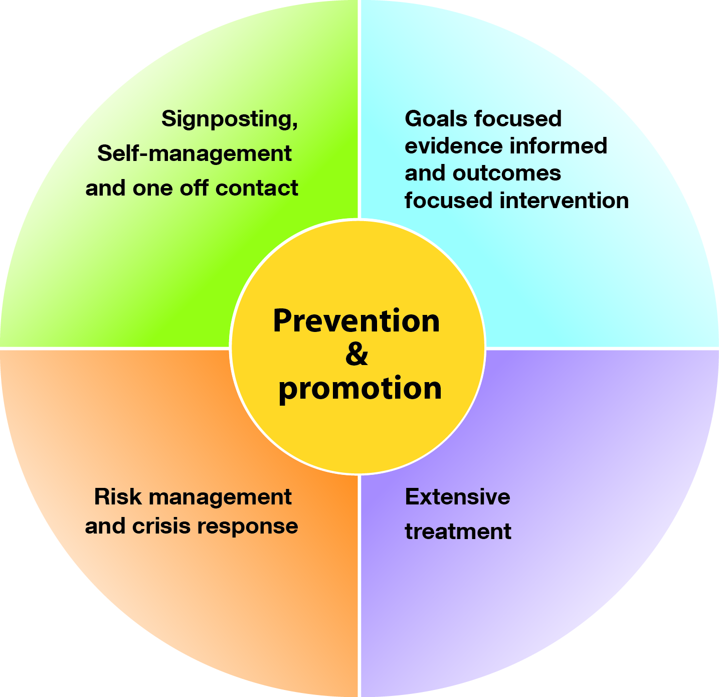
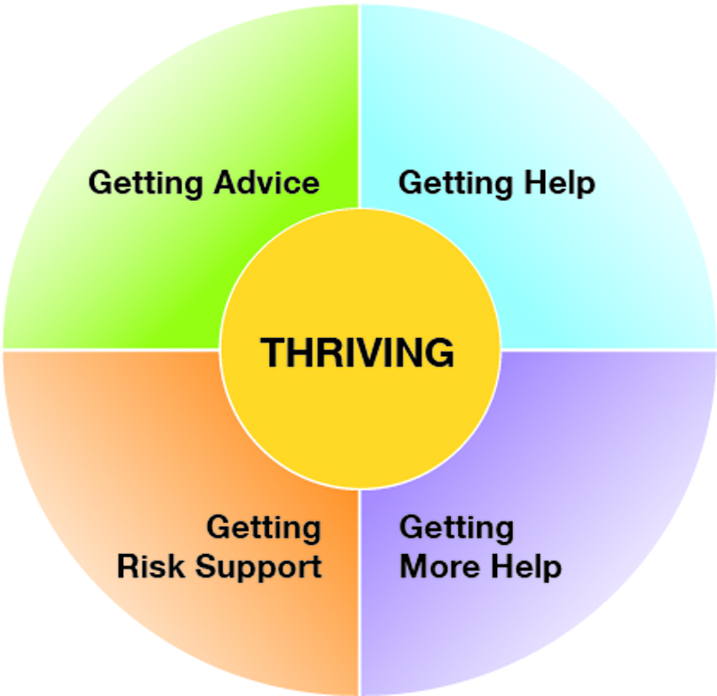
The THRIVE Model (2015)

Slide 21
Getting Advice
Getting Advice: Neurodevelopmental Assessment (NICE Guidance as Relevant) (NEU)
Getting Advice: Signposting and Self-management Advice (NICE Guidance as Relevant) (ADV)
Getting Help
Getting Help: ADHD (Guided by NICE Guideline 72) (ADH)
Getting Help: Autism Spectrum (Guided by NICE Guideline 170) (AUT)
Getting Help: Behavioural and/or Conduct Disorders (Guided by NICE Guideline 158) (BEH)
Getting Help: Bipolar Disorder (Guided by NICE Guideline 185) (BIP)
Getting Help: Depression (Guided by NICE Guideline 28) (DEP)
Getting Help: GAD and/or Panic Disorder (Guided by NICE Guideline 113) (GAP)
Getting Help: OCD (Guided by NICE Guideline 31) (OCD)
Getting Help: PTSD (Guided by NICE Guideline 26) (PTS)
Getting Help: Self-harm (Guided by NICE Guidelines 16 and/or 133) (SHA)
Mutually exclusive groupings
Getting Help: Social Anxiety Disorder (Guided by NICE Guideline 159) (SOC)
Getting Help: Co-occurring Behavioural and Emotional Difficulties (NICE Guidance as Relevant) (BEM)
Getting Help: Co-occurring Emotional Difficulties (NICE Guidance as Relevant) (EMO)
Getting Help: Difficulties Not Covered by Other Groupings (NICE Guidance as Relevant) (DNC)
Getting More Help: Eating Disorders (Guided by NICE Guideline 9) (EAT)
Getting More Help
Getting More Help: Presentation Suggestive of Potential BPD (Guided by NICE Guideline 78) (PBP)
Getting More Help: Psychosis (Guided by NICE Guidelines 155 and/or 185) (PSY)
Getting More Help: Difficulties of Severe Impact (NICE Guidance as Relevant) (DSI)

Slide 22
Learning from the CAMHS Payment System Project (2015) (http://pbrcamhs.org/final-report/)

Slide 23
Advances in data linkage
Consider a young person, Jonny, age 15
In school
Sees 3rd sector counselling service based in school
Absences, behavioural incidents and attainment
Contacts and outcomes
(e.g. SIMS)
(e.g. CODE)
Data linkage
Referred to NHS CAMHS
Sees GP, given medication
Outcomes
Contacts and medication
Contacts
(e.g. RiO)
(e.g.
COMMIT)
(e.g. EMIS)
= a record system/database

Slide 24
Advances in data linkage
In school
Sees 3rd sector counselling service based in school
NPD
Absences, behavioural incidents and attainment
Contacts and outcomes
(e.g. SIMS)
(e.g. CODE)
Referred to NHS CAMHS
Sees GP, given medication
MHSDS
CORC
Outcomes
Contacts and medication
CPRD
Contacts
(e.g. RiO)
(e.g. COMMIT)
(e.g. EMIS)
= a national database
= data flows
= future data flows

Slide 25
End thoughts

Slide 26
Helping measure complex reality
Below are examples of indicators relating to the sort of goals agreed by children, young people and families accessing services
Overarching theme | Agreed goal | Some possible outcome indicators that can be used
Relationship /interpersonal: | Make more friends Have better family relationships Have less fights Better management of child’s behaviour by parent | Strengths and Difficulties Questionnaire (SDQ); Child Outcome Rating Scale (CORS) SCORE Index of Family Function and Change-15 (SCORE-15) Me and My School (M&MS) Brief Parental Self-Efficacy Scale (BPSES)
Coping with specific problems and symptoms | Less symptoms PTSD Less low mood Manage intrusive thoughts and compulsive behaviours | Impact of Events Scale (IES) Strengths and Difficulties Questionnaire (SDQ); Revised Child Anxiety and Depression Scale (RCADS); How are things: Depression/low mood (PHQ-9) OCD subscale of Revised Child Anxiety and Depression Scale (RCADS)
Personal functioning: | Doing better at school Feeling happier | Number of days attending school; academic achievement Short Warwick-Edinburgh Mental Well-being Scale (SWEMWBS)

Slide 27
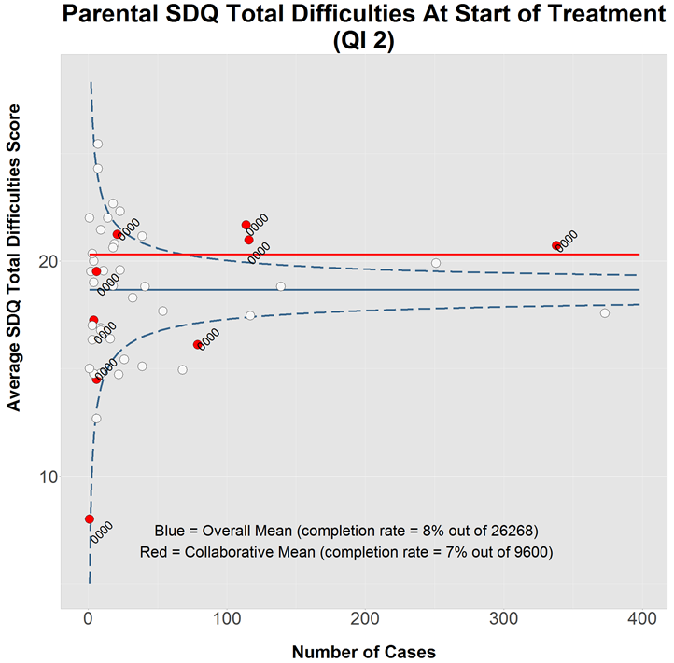
Helping make sense of messy data

Slide 28
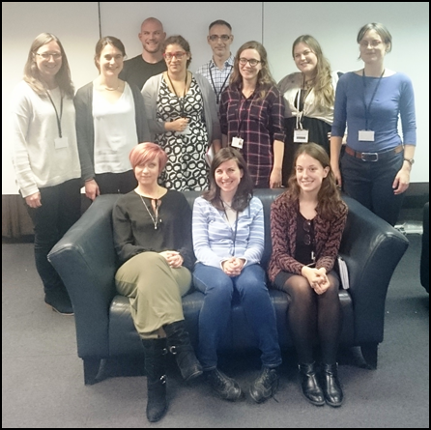
Corc@annafreud.org

