Slide 1
Update from CORC
Kate Dalzell, CORC Practice Lead
Ben Ritchie, CORC Informatics Lead

Slide 2
What to look back on - and look out for -
Our report on child- and parent reported outcomes and experience data 2011-15 – and the work it has stimulated
Supporting collation and learning from data
Defining, identifying and expanding on best practice use of outcome data
Dissemination – opportunities to share and to learn from others
Applying CORC learning more widely across the system of services supporting child mental health
Notes:
Give a sense of the rich range of work we have underway

Slide 3

Child- and Parent-reported Outcomes and Experience from Child and Young People’s Mental Health Services 2011-15
First ever analysis of routinely collected outcomes and experience data from 75 mental health services in England
Challenges for analysis include diversity of population, measures, metrics, lack of control groups or comparison data and data quality
Notes:
Published November 2016
The analysis aims to:
Advance the understanding of outcomes and experience of children accessing services
Highlight challenges and possible ways forward
Consider the best ways to measure and capture outcomes in the future

Slide 4
Engagement and debate
Seminars in Leeds, Birmingham, London
Blog pieces
Response from children and young people
Making the findings accessible
  See our waiting room poster!
Notes:
Language; too genearlised?; hard to know whether to share the data (feeling like a statistic; feeling worried about not achieveing recovery; ethics)

Slide 5
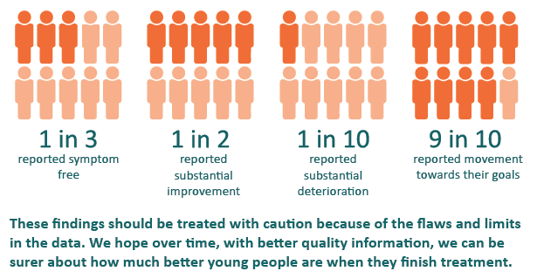
Key findings extract – self-report

Slide 6
Debates
Different ways of measuring and defining change
Language: how to talk about getting better
How to work with flawed, uncertain, proximate, sparse data
Do we have realistic expectations for children and young people’s mental health outcomes?
How do we talk about the limitations’ of services?
Notes:
Raw scores; reliable improvement; recovery; reliable recovery
CORC believes we need more services and that the right help can change lives. However, we also believe we have to be honest about the limits of what services can do given our current state of knowledge. CORC recommends the findings of this analysis are used to inform discussions involving practitioners, funders, service users, policy makers and others. Key topics for consideration in such facilitated discussions might include the appropriate metrics for considering outcomes and appropriate targets for given metrics.
We need acknowledge what is realistic, setting ourselves targets that, whilst they might stretch us, are grounded in what is possible.
We must think more clearly about how we support those who are not better having been seen by specialists by widening our conception of what services and support might look like
If we are serious about achieving parity of esteem between physical and mental health, we need parity of data. Better quality data on outcomes and experience of mental health services must be facilitated and incentivised to aid review and development of services. To achieve this, leadership focus, improved IT systems, better staff training and stronger incentives may need to be in place.

Slide 7
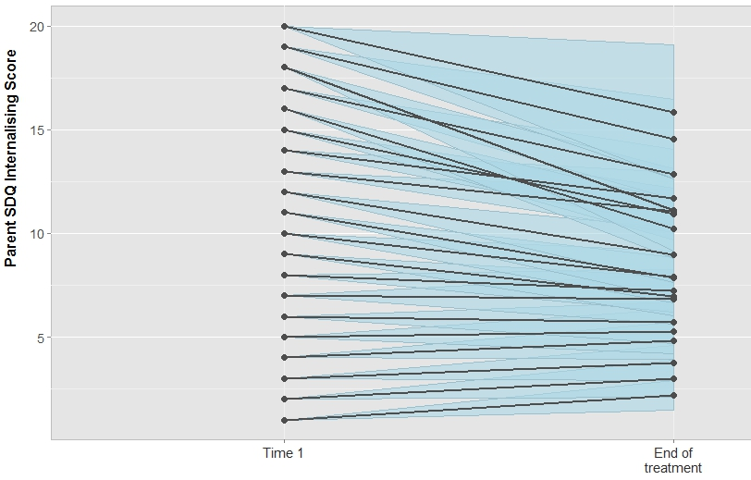
Trajectories over time – SDQ internalising

Slide 8

Beginning: focused conversations informed by “recovery” metrics
Given the difficulties you are experiencing, your history and your context I would expect you to have a X% chance of full recovery in terms of A as measured by B by C date.
We will look at all ways to help with Y but given your particular history and circumstances the chances of full recovery here are more like X%.
However, even if we cannot change things completely, we do find ways to live with these difficulties using strategies we can help you with.
Will I recover?
Notes:
Given what you have told me about how things are at the moment, and how things have been in the past, I think we can work together to make you feel substantially better in the next few months.
The self-report scale we are using will show us this improvement, but it might not show that your symptoms are completely gone.
Often some symptoms remain – for some people this may be some feelings of sadness, for others this may be sleep problems.
Even if we cannot change things completely, many people in your position learn ways of coping with these symptoms. W
e will focus on what is important to you and review your progress every time we meet on the self-report scale and on the other indicators we have agreed (such as attendance at school, going out with friends).
After six meetings we will review how things are going generally. We can then decide if it makes sense to change tack or to end treatment

Slide 9

Practice
Consider trajectories and end points from the outset
http://www.corc.uk.net/media/1490/trajectories_torch.pdf

Slide 10
Emergent work
What Constitutes a Good Outcome?
  Event on 3rd July - Royal Society of Medicine
Talking about endings
  Training now on offer
Talking about failure
  Tony Rousmaniere article, CORC features
Using outcome data to inform prognosis, and engage with likely trajectories
Research exploring key questions (see later slide)
Notes:
Lets them know we can be honest with each other about the possibility of failure
Signals we are taking the gravity of their challenges seriously
Helps the client see that they don't need to rescue me - the therapist – from my own insecurities
Signals they can't expect me to save them, because I am not superman: encourages some to step up
Facilitates expression of painful feelings: when these are recognized, more honest hope can emerge
Benefit for therapist
Improved self-esteem and self-compassion from a more balanced, realistic view of myself and my work.
A shift in focus from worrying if I am a good therapist, to focusing on gradually getting better through continuous deliberate practice.
More enjoyment from my work as I am relieved of the impossible pressure to heroically save all of my clients
More open and close relationships with colleagues: openly sharing challenges and failures helps us support each other.
Tony Rousmaniere, PsyD
http://www.drtonyr.com/
However, there is a lack of consensus about the types of change that constitute a ‘good outcome’, and an urgent need for better ways of theorising and measuring children’s mental health outcomes.
This workshop aims to stimulate an interdisciplinary debate about what constitutes a good outcome in child and adolescent mental health by bringing together speakers from variety of backgrounds. They include academics from:
CYP with experience of using mental health services
Philosophers
Research psychologists
Philosophers of science
Psychometricians (experts in measures and measurement)
Clinical psychologists
The aim is to take a step back, and to reconsider how we define and measure mental health and well-being in children, and how insights from the field of philosophy might help us challenge and improve current practice.
We hope that attendees will be open to share, listen and learn with and from others throughout the workshop.
The workshop will cover:
Existing approaches toward conceptualising and categorising outcomes in child and adolescent mental health
What do young people with experience of service use consider a good outcome from therapy?
Philosophical perspectives on mental health, well-being, and the ability to reliably report on one’s own state of mind.
The difference between mental ill-health and wellbeing outcomes
Issues and dilemmas around the measurement of child mental health outcomes.

Slide 11
Learning from data

Slide 12
CORC Research
Outcomes for anxiety and depression
Julian Edbrooke-Childs, Victoria Zamperoni and colleagues
Mapping trajectories for change over time
Elisa Napoleone, Prof Chris Evans and colleagues
Who fills in outcome measures
Carin Eisenstein and colleagues
Predicting outcomes
Zachary Cohen and others
Impact of complexity factors on outcomes
Karolin Krause and colleagues
Looking at change in specific symptoms over time
Praveetha Patalay and others
Notes:
Roehampton (Chris)
Seattle
Liverpool (Praveetha)

Slide 13
Learning from data
Supporting members to submit data to NHS Digital (MHSDS)
Analysing member data to support service improvement
  CORC reports
  Bespoke analysis
We would welcome your feedback on how to continue to make analysis of member data and the wider dataset relevant and valuable
Look out for our quickfire survey on data submission
Notes:
and continuing to see interest from (NHS-funded) members in submitting data to CORC [might need some thinking about how best to frame this]
We would welcome to hear Let us know In light of this we could say that we would find it useful to hear from members about how we can continue to make the support offered by CORC in regards to data and analysis relevant and valuable.

Slide 14
Defining, identifying, building on best practice

Slide 15


CORC Accreditation
Congratulations to:
Bromley Y, and
YPAS
The first organisations to be awarded CORC Accreditation in outcome and feedback measurement!

Slide 16


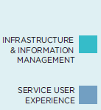
CORC Best Practice Framework
Structured process for working towards best practice
Whole system self-assessment, staff survey, and improvement plan development
Increasingly used for self-review
  Liverpool partnership; South Staffordshire;
  Anna Freud National Centre for Children & Families
Notes:
Explain that the Self-Assessment process using the Best Practice Framework was designed to be comprehensively completed as a whole system approach, with Senior leadership support, and involving staff survey, in-depth self-assessment etc.
AS this takes around 10-12 weeks for most organisations we are unable to complete this within the scope of today. However, we will use the Best Practice Framework to outline standards for Best Practice and enable you to think constructively about where any gaps in practice may lie, and therefore where you may best be able to focus energies on returning to your services.
We will be using tools to help you undertake a ‘rapid appraisal’ of where your practice currently lies, and you will have the opportunity to develop an Action Plan to take back to your service to support implementation and improvement.

Slide 17
Supporting best practice – training
Programme of training & learning events across the country – York, London, Manchester,
  Embedding best practice and use of outcome and feedback measures
  Choosing and using measures
  Interpreting outcome data in children and young people’s mental health
Now also on offer..
  When to stop treatment
  Sharing and managing outcome data
In development
  Free e-learning on measuring mental wellbeing for less specialist practitioners
Notes:
When, Why and How do Patients Change in Psychological Treatment
Dr Wolfgang Lutz, University of Trier
Measuring change in child mental health: what the data from CORC can tell us
Professor Miranda Wolpert, Anna Freud National Centre for Children and Families
How do we know that we have made a difference?
Professor Tamsin Ford, University of Exeter
ROM: The Dutch perspective
Bertine Lahyis, Karakter, and Professor Frits Boer, University of Amsterdam
CORC's approach to implementing ROM
Kate Dalzell, CORC
Implementing Routine Outcome Measures in a charity-delivered counselling services
Mick Atkinson and Dr Fiona Pienaar, Place2Be
Building a national quality register for CAMHS process and outcome data in Sweden
Olle Lindevall, National Registry for Child and Adolescent Psychiatry Sweden

Slide 18
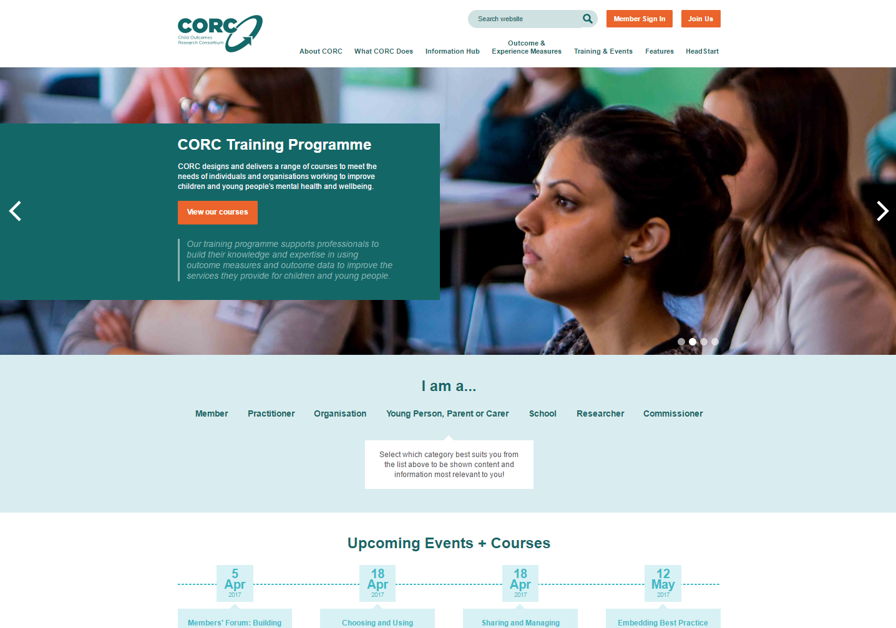

Slide 19

Supporting best practice - dissemination
New website!
  Regular blogs
  Information hub
  An (increasing) outcome measures database
Case studies (showcased in our monthly newsletter)
  Sussex; Northumberland, Tyne and Wear; AFNCCF; Bromley Y; Tees Esk and Wear Valley; Worcestershire; Berkshire

Slide 20
Broadening engagement
Schools members
Associate members
CORC Network
Growing international membership
International Event
New member consultation group
Developing joint bids
  Look out for Health Foundation Scaling Up Improvement
Notes:
How, Why and How do Patients Change in Psychological Treatment
Dr Wolfgang Lutz, University of Trier
ROM: The Dutch perspective
Bertine Lahyis, Karakter, and Professor Frits Boer, University of Amsterdam
Building a national quality register for CAMHS process and outcome data in Sweden
Olle Lindevall, National Registry for Child and Adolescent Psychiatry Sweden
4:thought. Working in schools (EHCAP)
HeadStart partnerships; smaller voluntary orgs
Urge individuals to join Network – 100s of people signed up
Tameside and Glossop
Children’s Society
Welcome to IWK Healthcare in Canada, CAMH Service in Australia
13 members on the member consultation group and 3 non members: advising on a range of projects and publications.
Building young person consultees as well – let us know if your participation groups would have an interest

Slide 21
Applying CORC learning more widely across the system of services supporting child mental health
Area approaches to outcome-focus
  Shared outcome frameworks
  Looking at different providers’ data together
Support to HeadStart – capacity building – using data to improve resilience and emotional wellbeing programme in six area partnerships
Notes:
Kent; Barking, Havering and Redbridge
PHE toolkit

Slide 22
Resources to help schools
Mental Health and Wellbeing Toolkit for schools
School training on measuring wellbeing
Support to HeadStart partnerships
  Wellbeing Measurement Framework for schools and colleges
Notes:
Kent; Barking, Havering and Redbridge
PHE toolkit

Slide 23
Come and see us in our new offices!
Jordan House
Brunswick Place
London N1 6EB
www.corc.uk.net
corc@annafreud.org

