Slide 1
Developing an outcome-focused service in Sussex Partnership: introducing the ROMs champion
Aryana Shirazi
Aryana.Shirazi@sussexpartnership.nhs.uk
Assistant Psychologist - East Kent CAMHS
Nicola Vince
Nicola.Vince@sussexpartnership.nhs.uk
Assistant Psychologist - East Kent CAMHS Eating Disorders Service

Slide 2
In 2014, the role of a Routine Outcome Measures (ROMs) champion was introduced across Kent.
“A Routine Outcome Measures (ROMs) champion is an appointed Senior Psychologist who acts as the intermediary between the overall ROM lead and the Assistant Psychologists (AP) in different teams.”
ROM Lead
ROM Champion
Assistant Psychologist
Notes:
Each team has a ROMs champion who supervises the respective assistant psychologist for that team.
The idea behind the appointment of the ROMs champions was to select senior psychologists who were believed to be “thought leaders”. The reasoning behind this was to appoint someone whose experience would be sought after in the MDT and whose voice would carry weight in decision making. We believe this to be the most crucial quality in an effective ROMs champion.
It also followed that as the Assistant Psychologists were hired to implement the ROM process, that their direct supervisors (i.e. the more senior psychologists), would hold the ROM champion role.
Psychologists can take on the role by expressing interest, however in our experience they have usually been appointed through discussions in local psychology meetings, based on the availability of psychologists in the team.

Slide 3
For example, a ROM champion would:
Attend monthly ROMs meetings with their AP and relay important decisions made in the ROM meeting to their team
Provide ROM supervision for APs
Support in the maintenance of ROMs completion rates in their team
Ensure ROM action plans are implemented within the team

Slide 4

The following five routine outcome measures are currently implemented across Kent in the main CAMHS teams:
Strengths and Difficulties Questionnaire (SDQ)
Revised Children’s Anxiety and Depression Scales (RCADS)
Children’s Global Assessment Scale (CGAS)
Experience of Service Questionnaire (ESQ)
Health of the Nation Outcomes Scales for Children
and Adolescents (HONOSCA)
Notes:
This is currently carried out as a paper exercise, with clinicians inputting reported scores on the patient system after completion.
Eating Disorders Examination Questionnaire (EDE-Q) – YP only
Mood and Feelings Questionnaire (MFQ) – parent and YP
Screen for Child Anxiety Related Disorders (SCARED) – parent and YP
Child Obsessive-Compulsive Inventory (CHILD OCI) – YP only

Slide 5

Considering the effectiveness of ROMs champions
Impact can vary across teams depending on the availability of staff for the role
Different areas/teams can have different procedures therefore the role of ROM champion needs to be adaptive
Where ROM champions are in place we have been able to deliver more training to teams
ROM champions provide continuity in implementation and feedback
Notes:
This is based on the consideration of staff working hours and staff numbers within a given team.
For instance, in some teams admin support in posting out ROM at T2 & closure.

Slide 6

These measures are all given out at initial assessment (Time 1), at 4-8 months after assessment (Time 2), and at case closure.
Case Study from West Kent
Problem:
Since data collection began on outcome measures, we have found poor completion of ROM at T2 and closure.
What we wanted to achieve:
Improve clinician’s engagement with ROM implementation to increase completion rates.
Notes:
What we had done:
We had added to clinicians stress and workload by taking a punitive stance on non-completion of measures, making clinicians feel as if they were under surveillance.
This fed into the perception that clinicians are asked to do thankless tasks and not appreciated for it.

Slide 7
How we did it:
Improved clinician's self-efficacy around completing ROMs in session
Gave individual feedback of measures already collected to improve confidence and establish trust to improve engagement
Outcome:
Completion rates improved according to the months we provided training in team meetings (or at away days). The rates dropped off again in months where we didn’t do this.
Conclusion:
Raising the profile of ROM and keeping a continuous dialogue open around its use and benefits, twinned with data feedback can improve completion rates, but we need to work on the retention of this effect .
Notes:
In session ROMs are known to be best practice in order to be used in a clinically meaningful way/we also find that return rates are poor on ROMs that are posted to patients and families. This was done by providing training on ROM implementation in sessions, where the CORC training videos were shown to clinicians and discussed with regards to their clinical use.
2) Where clinicians have collected Time 1 and Time 2, and/or closure, we can provide a visual graph mapping the child’s progress. For the experience of service questionnaire, we have also created word clouds of service users’ and their families comments. This provides feedback to the teams, boosting moral and highlighting areas that need improvement.
3) However we found that it’s important to work on the retention of this effect to prevent clinicians disengagement with implementing ROMs.

Slide 8
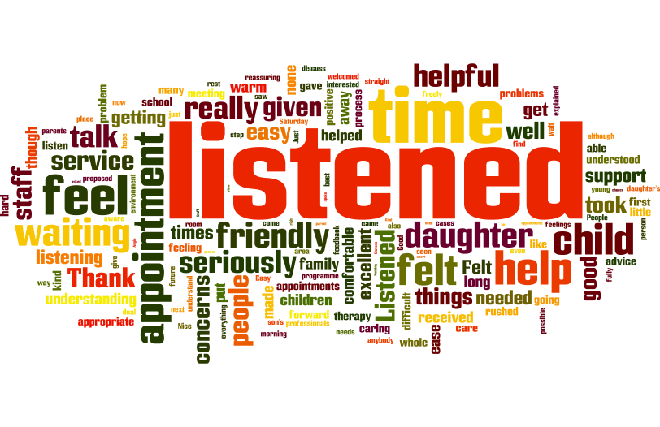
Parents Experience of Service Questionnaire Word Cloud

Slide 9

Young People’s Experience of Service Questionnaire Word Cloud

Slide 10

Case study from South Kent
Problem:
We found that clinicians were waiting for young people (YP) and their families to complete or post back ROMs before completing the clinician rated measures (the CGAS and HONOSCA).
What we wanted to achieve:
We wanted to encourage the completion of CGAS and HONOSCA regardless of whether other ROMs had been posted out, received back, completed in session or refused to be completed.
Notes:
What we wanted to achieve: This is because in theory, we could have a 100% completion rate of the clinician rated measures.
1) This meant that CGAS and HONOSCA completion rates were poor unnecessarily, as clinicians can complete these even if the YP and/or their families don’t want to or don’t post back ROMs.

Slide 11
How we did it:
The South Kent ROM champion and AP encouraged regular inter-rater reliability sessions amongst clinicians after weekly team meetings.
Outcome:
Since these sessions were introduced, CGAS and HONOSCA rates have stayed around the same as patient measure completion rates.
Conclusion:
There needs to be further exploration of why clinician rated measures are still poor.
Notes:
How we did it: These ensure clinicians are using these measures as a clinical judgement task rather than an administrative task.
This also helps to moderate the variability in subjective levels of clinical judgement.
Conclusion: We have had some informal discussions in team meetings to explore why CGAS and HONOSCA rates are still poor and found that sometimes there aren’t completed as a result of competing demands on clinicians time. Other times clinicians are unaware of the clinical use of these measures or believe that the service is using too many measures.

Slide 12

ROM Champion & AP: A collaborative approach
In trying to raise the profile for ROMs across the different teams, our regional APs and ROM champions have worked together in empowering our fellow clinicians to implement ROMs.
In the Child in Care team, the presence of an AP is a recent phenomena: a ROMs process flowchart was cascaded via e-mail to the team to show the exact process and responsibility of each team member.
“ROM clinics” were also put in place for staff who wanted support in learning to score and input ROMs on our patient system.
Overtime, this has lead to regular use of ROMs across a wider range of clinicians.

Slide 13

ROM Champion & AP: A collaborative approach
In East Kent, we have started to implement a monthly ROMs update e-mail, to enable the team to see our latest completion rates for each measure.
In addition to this, we have created a checklist pack for clinicians which covers everything they need to implement for their clinical cases. E.g. risk assessments, care plan etc. This pack also includes a ROMs checklist and ROM process flowchart to visually aid clinicians and to encourage automatic ROMs completion.
Notes:
The purpose of this was to keep ROMs at the forefront of clinicians minds, and to create motivation to continually beat previous months’ rates.
Automatic – and by automatic completion, we still mean it requires clinical judgement, adequate thought and ought to be used clinically within sessions, but becomes seen as mandatory in clinical case management.

Slide 14
Kent Assistant Psychologists’ experience of ROMs Champions
In our experience, having ROM champions has been a great asset to our Kent wide ROM process. This is especially true in areas where the champion has capacity to be actively involved in the upkeep of the ROMs improvement plan.
“From an AP perspective, it’s highly valuable having someone to reinforce tasks that are asked of clinicians”
“the presence of a ROMs champion works by feeding back the progress of ROMs into local leadership teams. This then creates continuity and consistency in the ROMs process across Kent ”
Notes:
What we can suggest is that anyone considering to become a ROMs champion needs to allotted enough time in their job plans, as this can sometimes be a demanding role.
The ROMs champion would need to work very closely with the Assistant Psychologist so regular supervision time would need to be allocated to discussing ROMs matters.
We have found that it’s quite crucial that the ROMs champion attends the monthly ROMs meeting in order to stay up to date with the latest progress and matters arising. This saves a lot of time from the AP feeding back from the meeting each month!

Slide 15
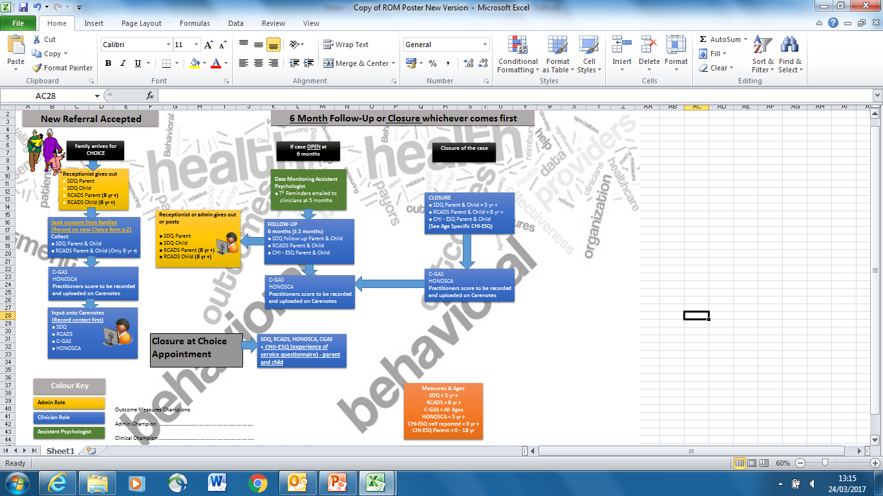
Notes:
For visualisation’s sake, we have included our ROMs process flowchart, which we emailed to clinicians and included in their packs. If anyone would like to see this in more detail, or find out any more information about anything that we have said, we would be more than happy to talk to you today or communicate via email.

Slide 16
With thanks to:
Jenny Cooke – Assistant Psychologist – West Kent CAMHS
Jennifer.Cooke3@sussexpartnership.nhs.uk
Faiben Yemane – Assistant Psychologist – South Kent CAMHS
Faiben.Yemane@sussexpartnership.nhs.uk
Kiran Shetra – Assistant Psychologist – CAMHS Child in Care team
Kirandeep.Shetra@sussexpartnership.nhs.uk
…and the ROMs and respective clinical teams!
Thanks for listening!
Notes:
We would like to thank the other assistants and our respective teams for helping us continually improve our service. Thanks for listening!

