Slide 1

Using data to transform lives: making the most of CORC reports
CORC Members’ Forum 5 April 2017: Building an outcomes-focused service
Rachel Bryant-Waugh
The child first and always
The child first and always

Slide 2

Plan for presentation
The purpose of CORC reports
Our context at GOSH
What did we learn?
What tasks have we set?
Why this is so important?
The child first and always

Slide 3

The purpose of CORC reports
To collate and analyze routinely collected data related to outcomes and experience for CYP and their families to inform our practice and service development
To allow comparison with other CORC member services - important for benchmarking
To underline the importance of mental health related outcome monitoring in our specific setting
The child first and always

Slide 4


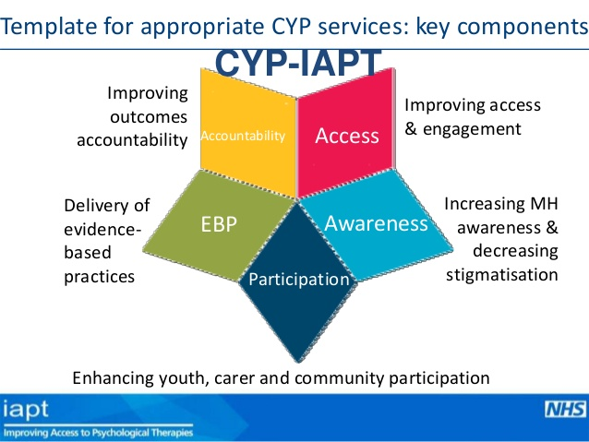
The purpose of CORC reports
To ensure we are in line with key national directives, by:
  Monitoring whether we are providing effective care
  Assisting with developing our workforce
  Strengthening accountability and transparency
The child first and always

Slide 5

Our context at GOSH
National specialist children’s health care provider
The ‘child first and always’ – always values with explicit focus on improving patient experience and enhancing staff engagement in all aspects of care delivery
Mental health department with in-patient and specialist out-patient teams – recent CORC member
The child first and always

Slide 6
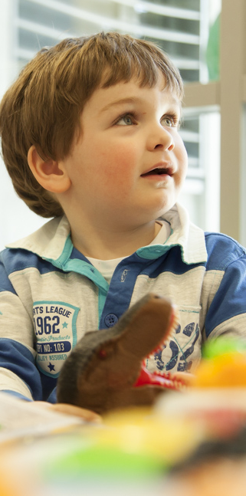
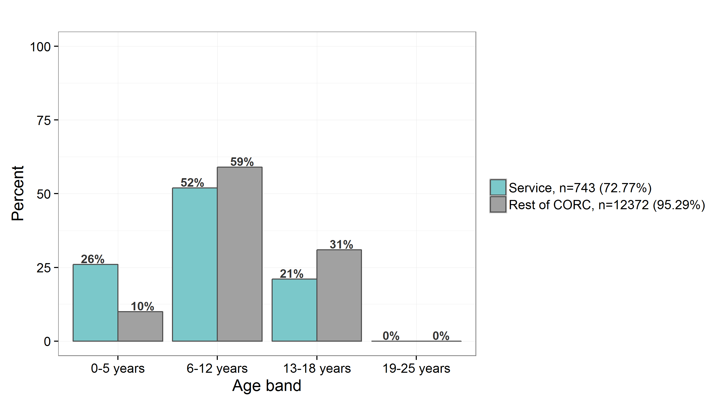
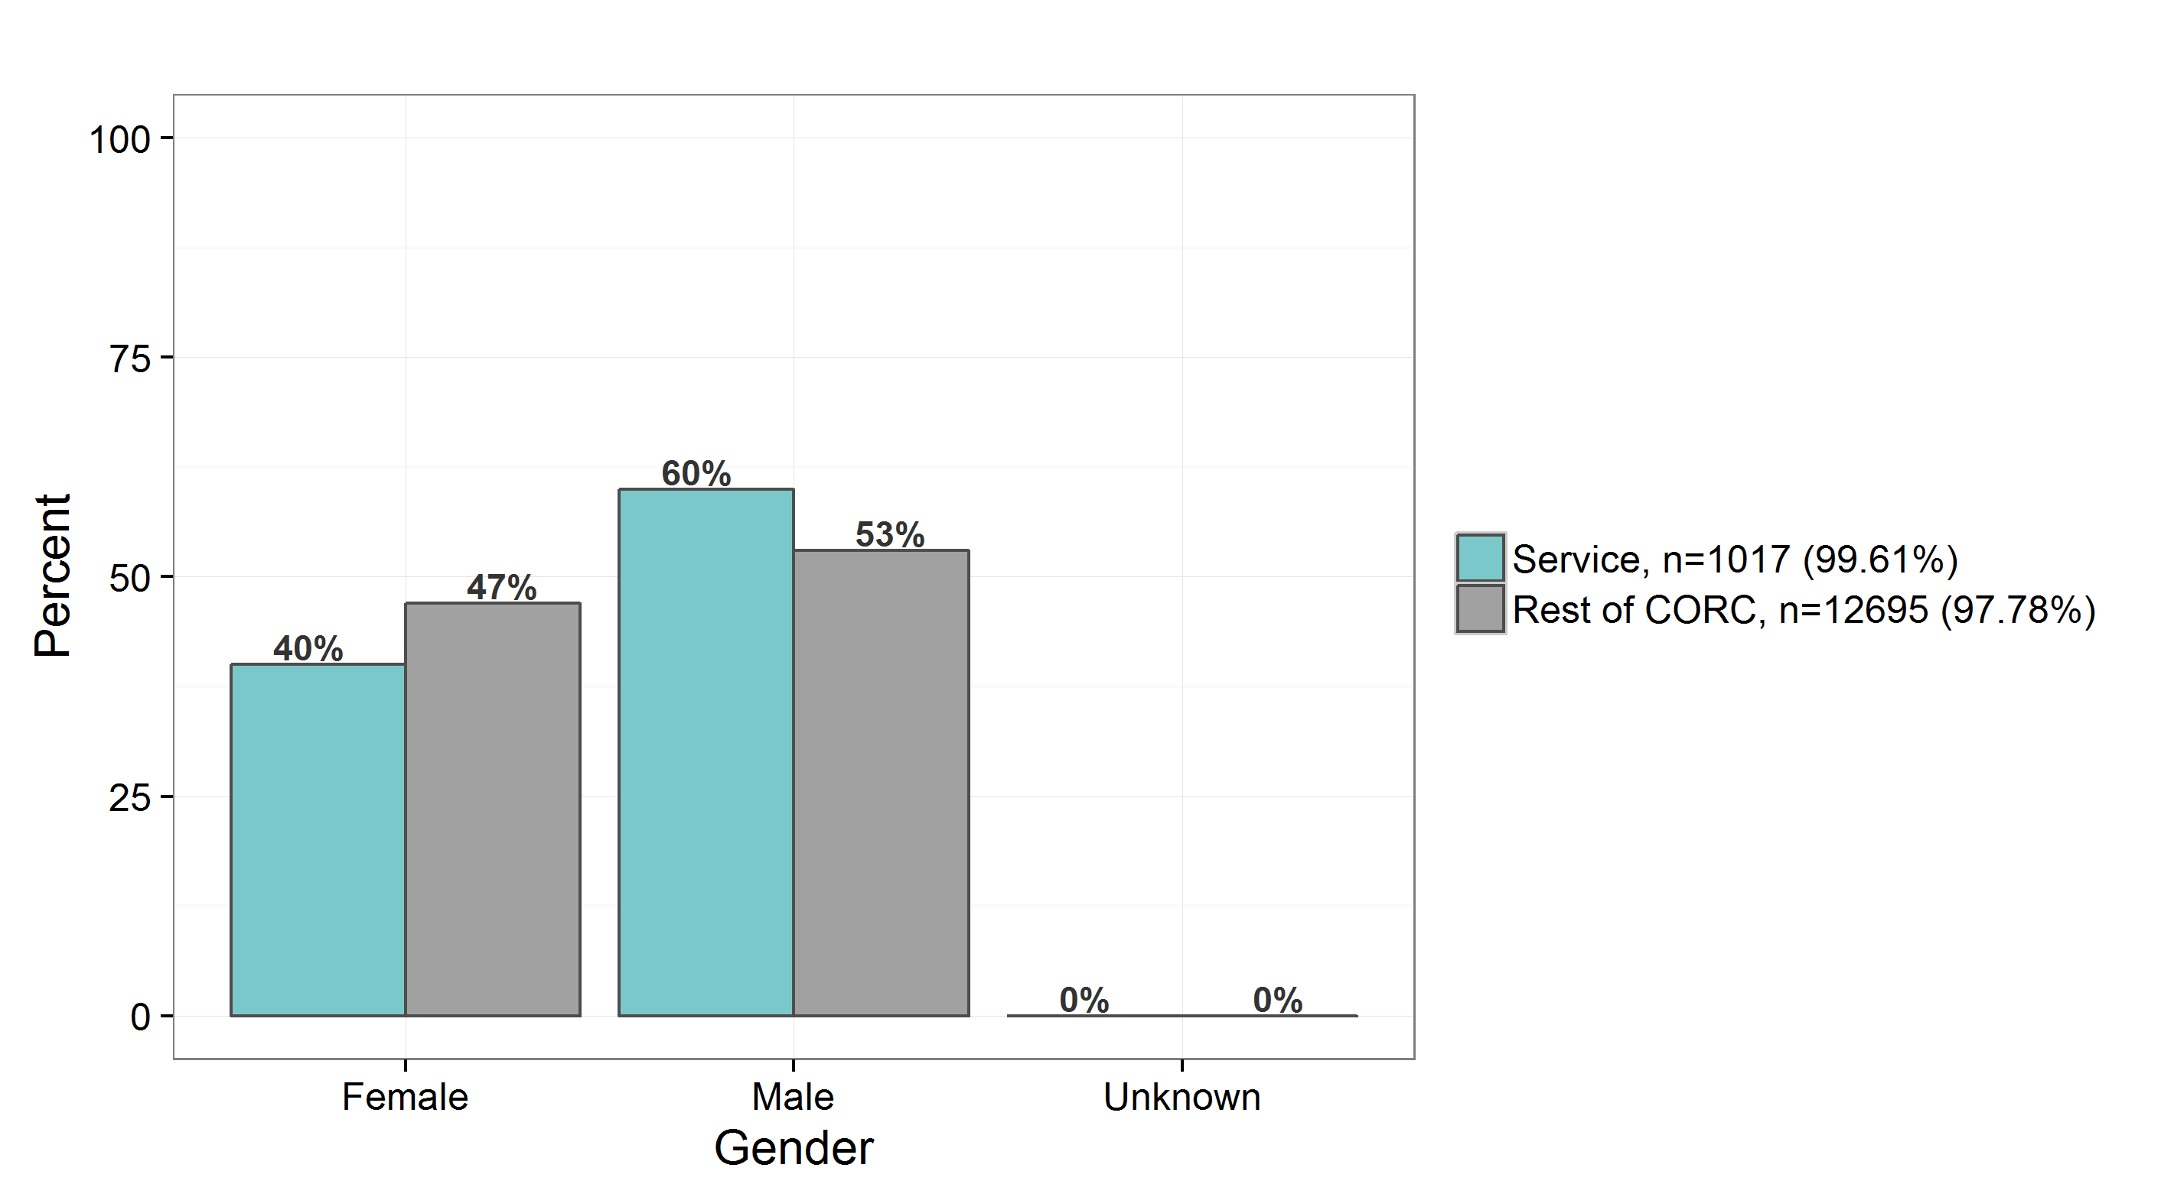
Our context at GOSH
The child first and always

Slide 7


What did we learn?
In terms of being in a position to submit our data…….
We needed to create a forum for discussion about measures and procedures
We needed to foster a sense of collective ownership and shared purpose
And more than anything…
any change takes time!!
The child first and always

Slide 8

What did we learn?
In terms of the results of our report…..
We need to do better in terms of our completion rates!!
Generally our outcomes are in line with others’ –
except for CGAS where progress is greater for CYP seen at GOSH (perhaps in line with severity of presentation at a national service)
The child first and always

Slide 9

Main challenges
Uptake
  Initial ‘buy in’ across CAMHS department
  Remembering to administer and complete measures
  Not being clear about last session for T2
  Poor follow-up return rate
Data entry
  Staff resources
  More missing data than needed
  Database infrastructure
The child first and always

Slide 10

What tasks have we set?
Specific team targets for improvement on uptake rates
Aim to achieve better consistency and inter-team support around data capture and reporting processes
To use our report as fully as possible in relation to its envisaged purpose
The child first and always

Slide 11

The purpose of CORC reports
To collate and analyze routinely collected data related to outcomes and experience for CYP and their families to inform our practice and service development
To allow comparison with other CORC member services - important for benchmarking
To underline the importance of mental health related outcome monitoring in our specific setting
The child first and always

Slide 12
The purpose of CORC reports
To ensure we are in line with key national directives, by:
  Monitoring whether we are providing effective care
  Assisting with developing our workforce
  Strengthening accountability and transparency
Improving reliability through higher completion rates
Highlighting areas for improvement/closer scrutiny
The child first and always

Slide 13
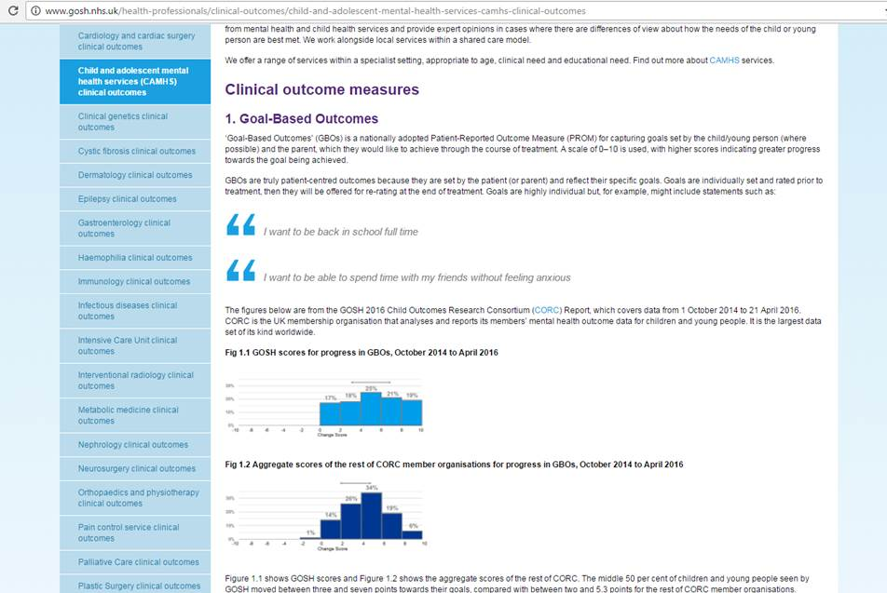
Sharing the importance of MH outcomes
The child first and always

Slide 14

Why is this so important?
We need to ensure our data are representative of the children and young people that we work with
Representative data can better inform our practice and help us to develop responsive services
We need evidence that our interventions are consistently optimally helpful to those receiving them
The child first and always

Slide 15
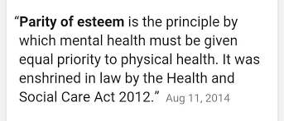


Why is this so important?
The child first and always

Slide 16

Acknowledgements
Our patients and families for providing the data
Meredith Mora, Trust Outcomes Lead
GOSH Quality Improvement Team
DCAMH colleagues
The child first and always

Slide 17

Thank you for your attention!
rachel.bryant-waugh@gosh.nhs.uk

