Slide 1
Dr Jane Mischenko
Lead Commissioner, Children and Maternity service, NHS Leeds CCGs
Sally Marriott
CORC Regional Support Officer
(North East)
Harnessing outcomes, participation and evidence (HOPE): learning from Leeds
Notes:
Tell you a little about Leeds- the context
In essence provide a case study from Leeds –
Key points being –
The importance of working with partners across the whole system – and the how we are doing it (strengths and challenges)
Following the principles of CYP IAPT
Establishment of the HOPE steering group and involvement of CORC to support us

Slide 2
Future in Mind: Leeds
Vision
Our vision is to develop a culture where talking about feelings and emotions is the norm, where it is acceptable to acknowledge difficulties and ask for help and where those with more serious problems are quickly supported by people with skills to support those needs.
Notes:
This vision – key issue flagged by CYP
To deliver this we recognise the need for us all to work together – to ensure the adults who are there to support children and young people in our city are confident, skilled and equipped to identify and support emotional and mental health needs
Key stats here:
273,000 CYP: age 0-25 years
278 schools
18,000 school staff
8 colleges and 3 universities
3 NHS trusts and 107 GP Practices

Slide 3
Voices of young people
Notes:
Voices of CYP strongly inform content of strategy and plan – have done from beginning and continues to be the case
Supported by consultation by Young Minds and Leeds Health watch at the beginning – now integral to every development across the system
We expect CYP voice to be listened to in their own care and in co-production of new services/ pathways and products – example is MindMate website – from day one CYP developed content, language and design and recruited website developers – this continues – CYP panel oversees and has to approve content – as indicated by the thumb badge

Slide 4
Notes:
A couple of years ago undertook a review (data, mapping of services etc) but crucially CYP & families and professionals
Key factors CYP wanted –
Address the stigma
Easy to access information for us (CYP) on emotional and mental health
Support and training for teachers
Clear pathways to specialist help for teachers (and GPs) when needed
Quick support – especially if in crisis
Listened to in developing our care
Supported not abandoned if we need to move to adult care as we get older
Extra support for the most vulerable with the most complex needs

Slide 5
Help!
Notes:
Another key issue flagged by CYP right at the beginning – confusion of pathways in trying to get support
Also very powerfully - A COMPLEX SYSTEM THAT IS DIFFICULT TO UNDERSTAND AND NAVIGATE:
18 months ago work commissioned from Young Minds and Youth Watch (part of local Health Watch) worked with Leeds CYP to understand their pathways – only 14 CYP – but shows complexity
Consultation with professionals, parents and CYP confirmed no one clear of what was available in Leeds, or how to access – disconnected and confusing system
Led to whole system model – work to clarify and support pathways and introduction of a SPA – has been in place over a year now – method of clinical triage managed by CAMHS but colleagues from whole system part of SPA team.

Slide 6
Notes:
A key principle is helping as early as possible – supporting CYP, families and schools to build EMOTIONAL RESILIENCE, for professionals to feel able to listen to CYP expressing emotional difficulties and to know where to get support (also working on pregnancy and early years – recently review PNMH pathway and we have excellent infant mental health service)

Slide 7
Notes:
Today particularly focussing on number 9
Working across the Leeds system - How research and evidence will help improve the quality of care/ how CYP will be involved in decisions about their own care and consulted on their experiences.
Followed on from commitment to use principles of CYP IAPT across the whole system
Led to the development of HOPE steering group and involvement of CORC
All services – working to bring down waiting times – key issues for CYP/ and working across system in HOPE group…

Slide 8
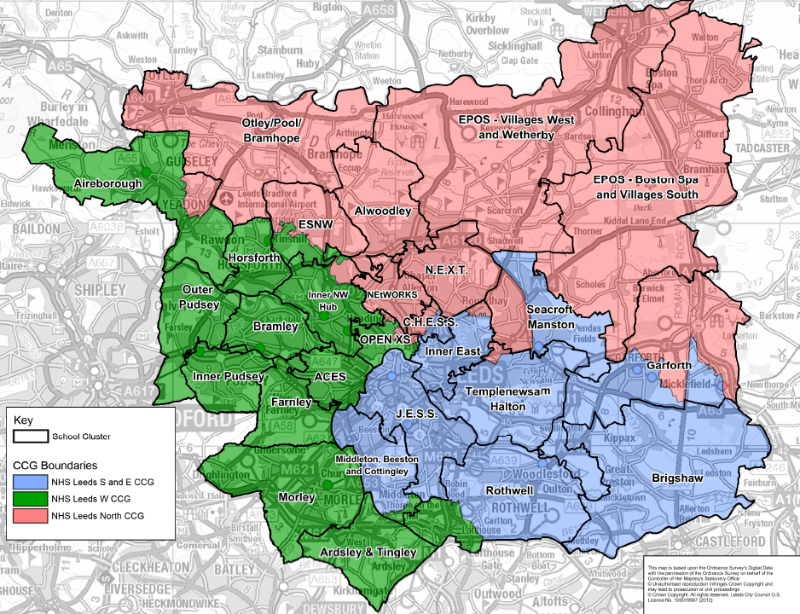
Notes:
Explain the 25 clusters and how across the partnership we have built the Early intervention service for each of these from a few TaMHS pilots to current cross city co-commissioning model
Developed across the city over several years of a joint innovation fund and match funding to prove the concept – valued and sustained by schools
That it is now co-commissioning model – CCGs piloted 2 years of enhancement to ensure schools/clusters key stakeholders in the whole system – data / flows/ approaches
Just agreed CCGs and LA will continue this with the clusters for at least the next 3 years
That we are collecting data – have full 12 months now – includes numbers, presenting need, waiting times and impact (SDQs, feedback and case studies)
Also have a SILC cluster network (more recent development)
Explain clusters and how across the partnership we have built the Early intervention service for each of these to current co-commissioning model
That it is a co-commissioning model – commission 3rd sector mainly – some commission from the CAMHS provider
That we are collecting data – have full 12 months now – includes numbers, presenting need, waiting times and impact (SDQs, feedback and case studies)
Importance integral to whole system – via SPA

Slide 9
Work So Far: Measures and Data Process
Specifically SDQ and GBO
4 different teams
1 day on site
Notes:
Specifically SDQ and GBO
4 different teams
mental health service
social care service
2 school clusters
1 day on site with each to:
Find out what they collect and when
How it is ‘handled’ i.e. inputting, storage
How it is accesses
How it is analysed and used for learning and development

Slide 10
Work So Far: Measures and Data Process
Key Findings
IT differences
Inconsistent analysis
Feedback loops to staff
Focus
Data challenge
Notes:
Key Findings:
All using different IT for storing and processing data; ranging from integrated service user record system to paper files and spreadsheets
Analysis at a service level is inconsistent
Feedback loops to staff after the data has been aggregated are better embedded in some services
Focus often on data completeness rather than learning and development
General use of data to look at specific team / intervention impact is a challenge

Slide 11
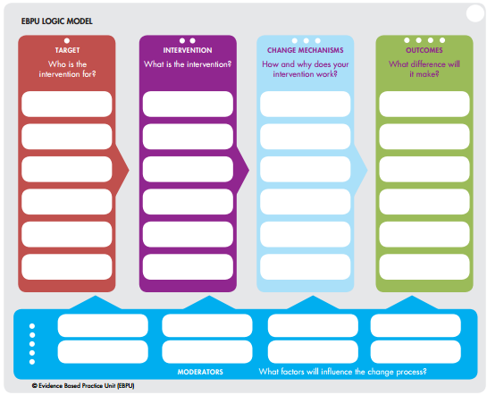
Work so Far: Understanding Your Model
Purpose
Using the EBPU Logic Model with 6 services
Notes:
Purpose: to identify common themes of delivery, understand the evidence base and how interventions are being measured, recognise common moderators of success
Using the EBPU Logic Model with 6 services:
Alternative Provision Schools
Schools Cluster
Voluntary Community Sector organisation
Multi Systemic Therapies
Local Authority Educational Psychologist Team

Slide 12
Work so Far: Understanding Your Model
Key Findings
Outcomes at the individual level
Aggregating the outcomes
Method of assessing SEMH needs
Bottom up approach - evidence based intervention
Case co-ordination
Notes:
Key Findings
Outcomes at the individual level is a key focus with lots of qualitative data
Finding ways to aggregate these outcomes to a service/team level, and consistently across services, is a challenge
Not one method of assessing SEMH needs: all using similar but different ‘checklists’
Bottom up approach to deciding on the evidence based intervention
Case co-ordination across agencies is challenging and can result in conflicting goals

Slide 13
Strengths and Challenges
Outcomes for children and young people
Excellent buy in and attendance to ‘the discussion’
Conflicting ‘targets / indicators’
Notes:
Agreement on overall outcomes for children and young people
Excellent buy in and attendance to ‘the discussion’
Conflicting ‘targets / indicators’ for agencies can drive conflicting actions

Slide 14
Thank you for listening ☺

