Slide 1
How to create an outcome-focused service
Birgit Valla
Leader and psychologist
Stangehelp

Slide 2

Why do we need to be outcome focused?

Slide 3
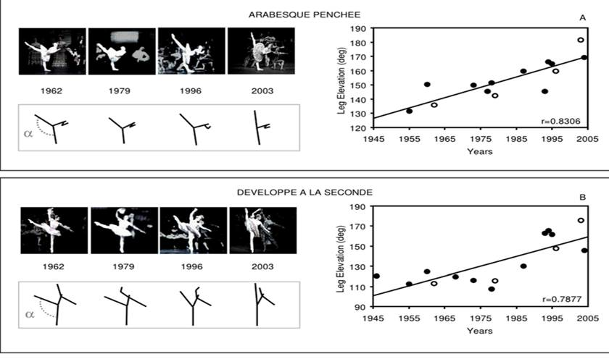

Slide 4
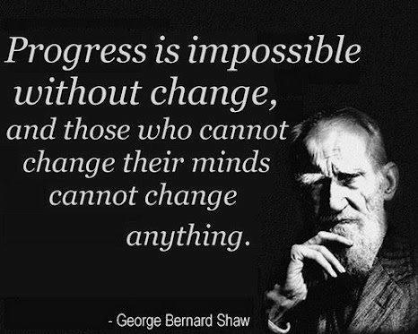

Slide 5



Slide 6
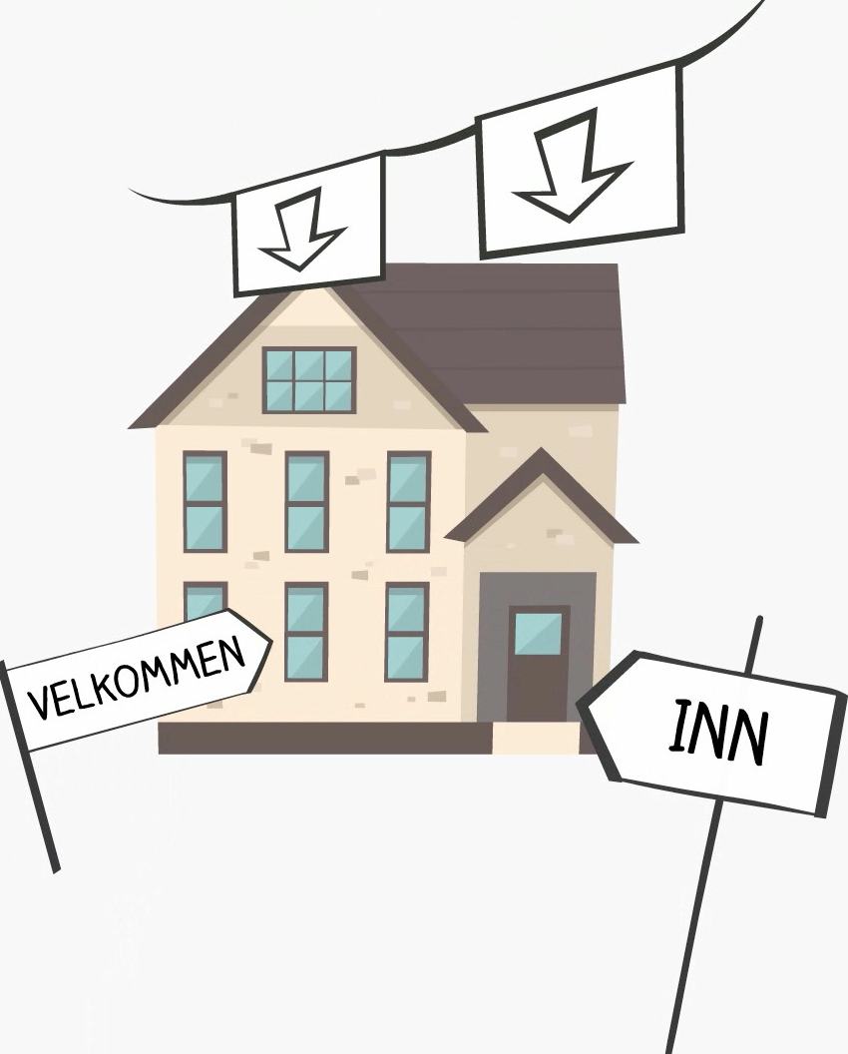

Slide 7


Slide 8


Slide 9


Slide 10
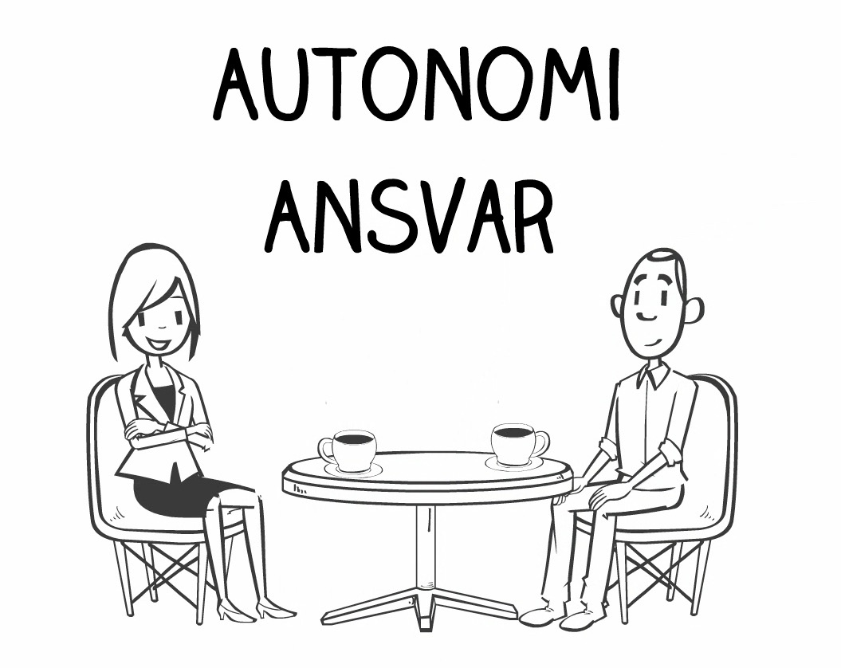

Slide 12
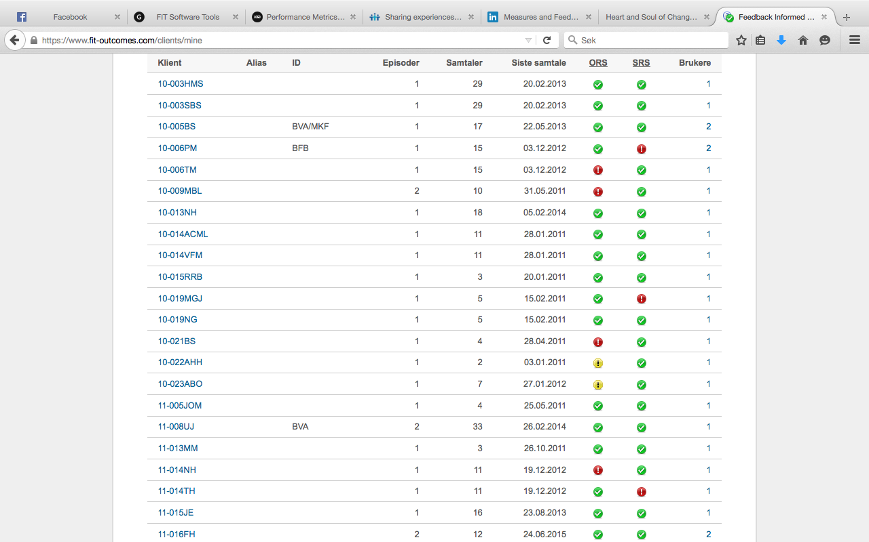

Slide 13
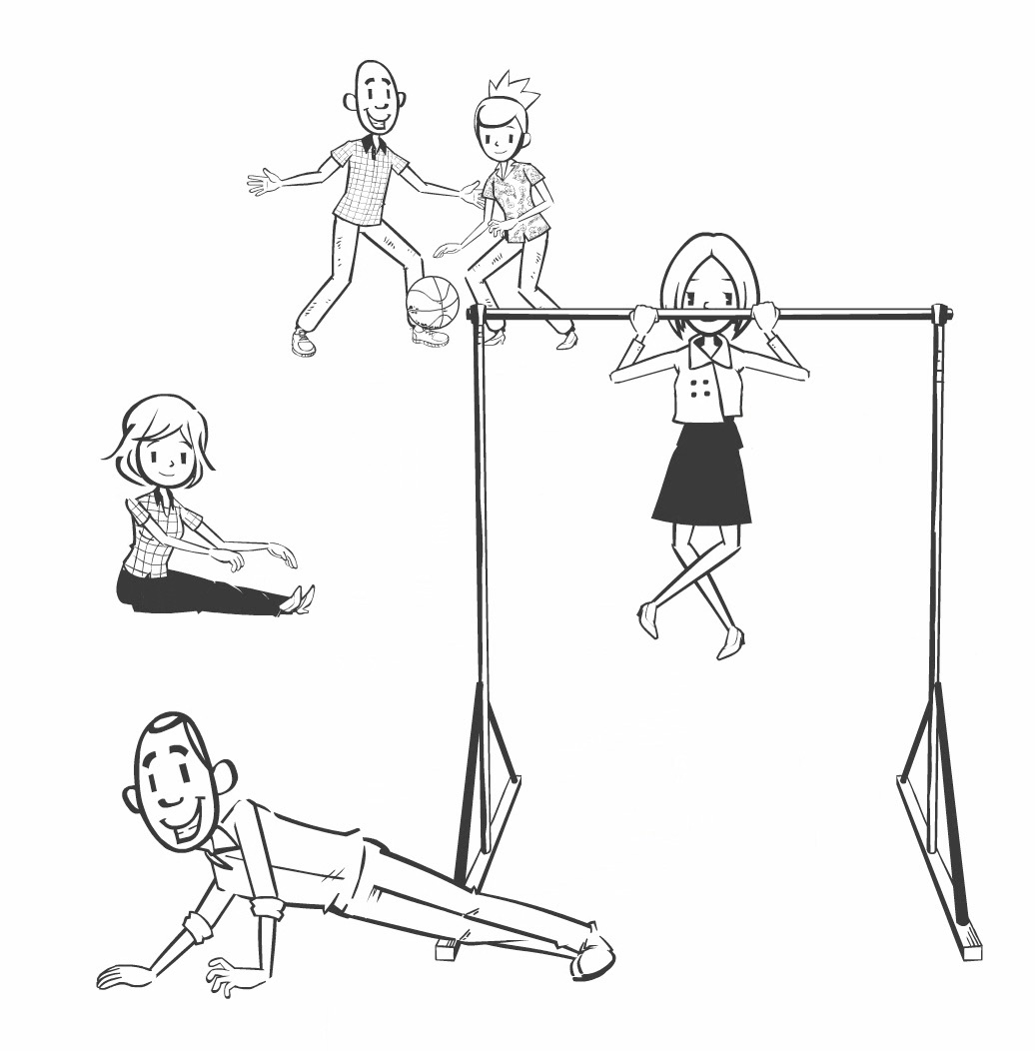

Slide 14
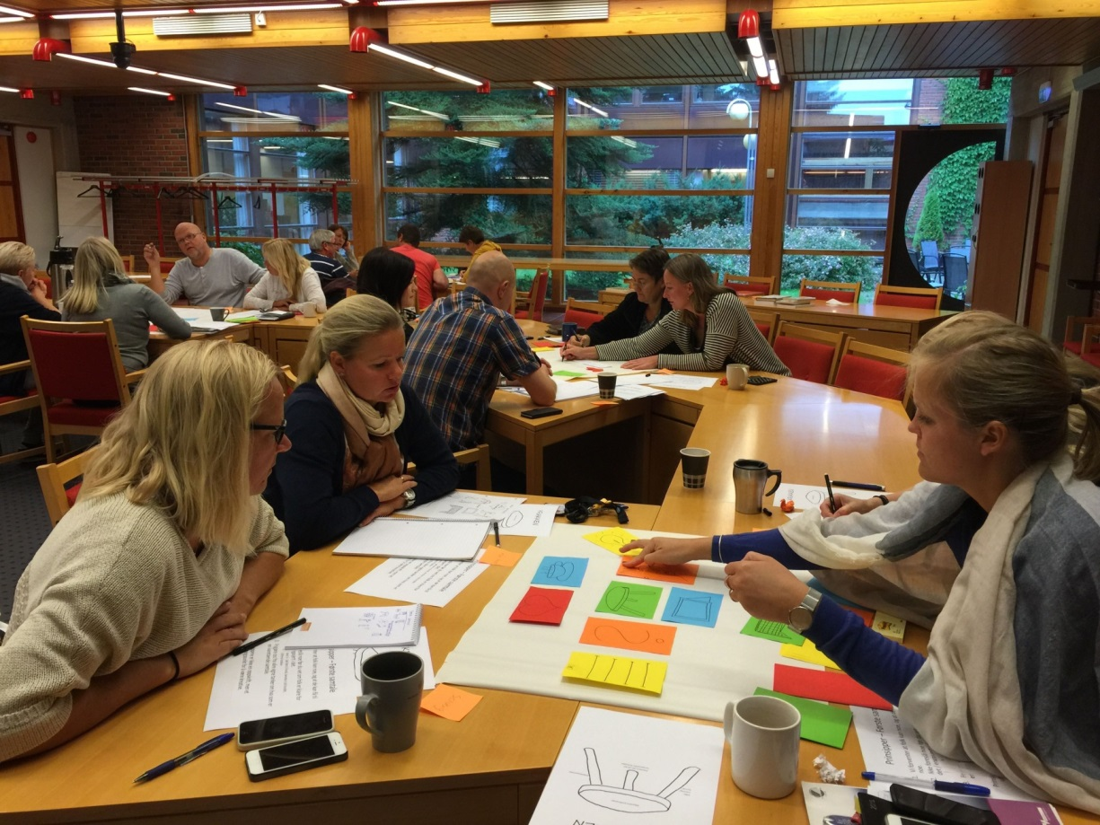
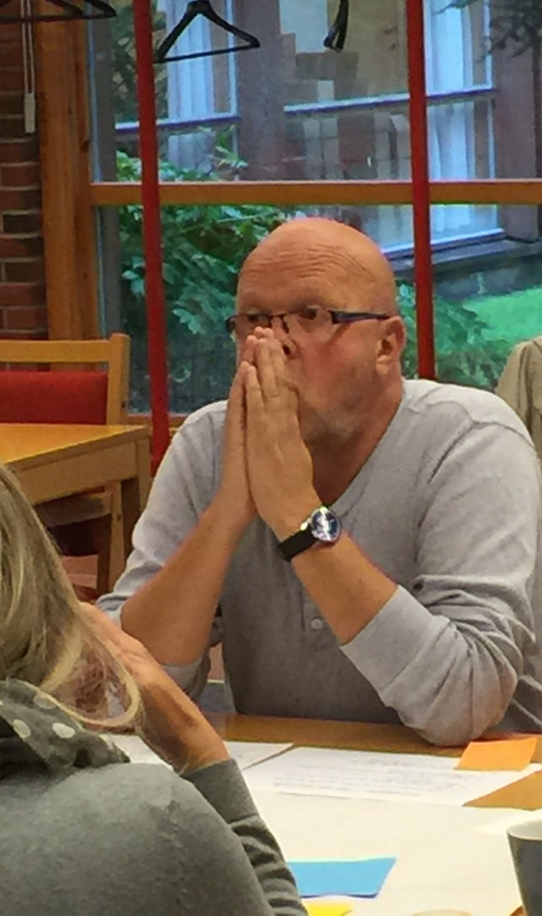
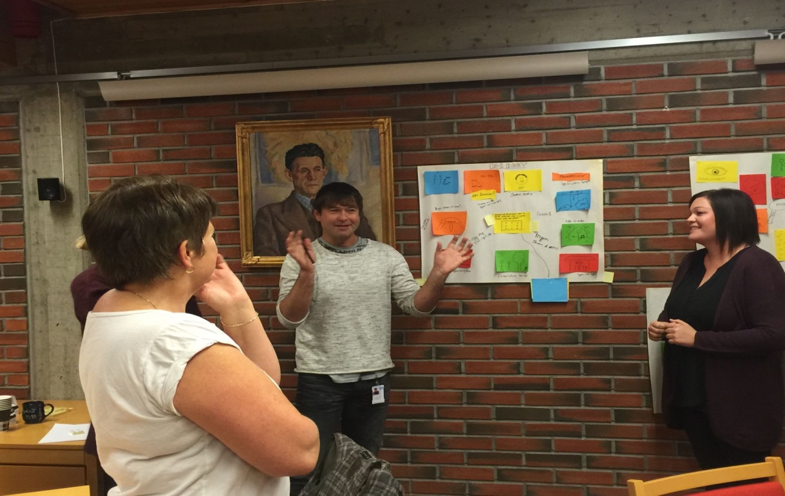

Slide 15


Slide 16
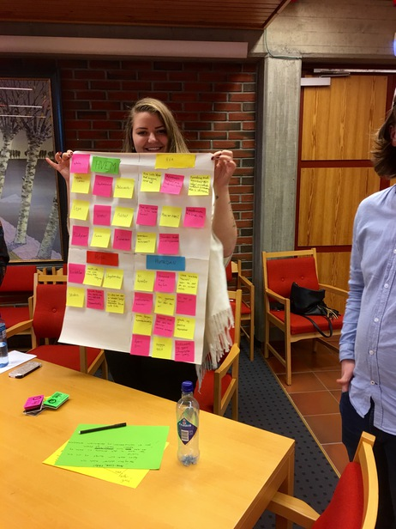

Slide 17


Slide 18

1. We help more people

Slide 19
People seeking help 2014 - 2016
Percentage increase people seeking help 2014 – 2016 = 80 %

Slide 20
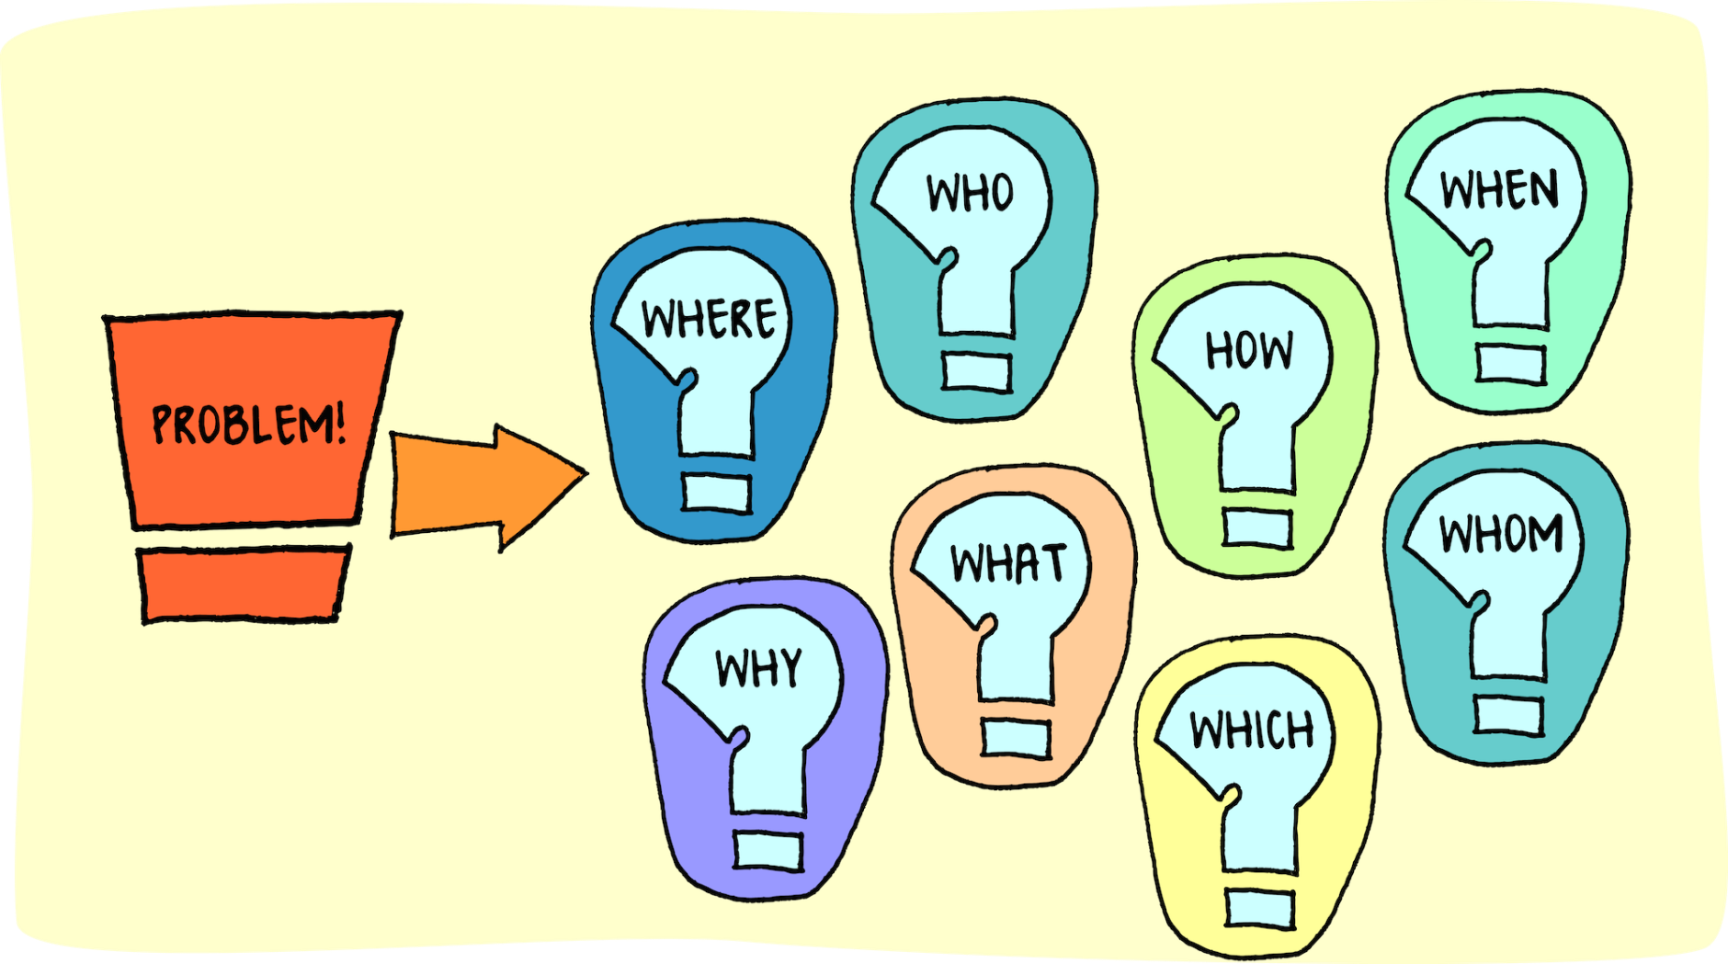
2. We help more people with more problems

Slide 21

3. We help more efficient and effectively

Slide 22
Referrals 2008 - 2014
Percentage increase referrals
2008 – 2014 = 37 %

Slide 23
Active clients 2008 - 2014
Percentage increase active clients 2008 – 2014 = 171 %

Slide 24
People seeking help 2014 - 2016
Percentage increase people seeking help 2014 – 2016 = 80 %

Slide 25
Active clients 2014 - 2016
597
467
Percentage increase people seeking help 2014 – 2016 = 23 %

Slide 26
But are we actually helping?

Slide 27
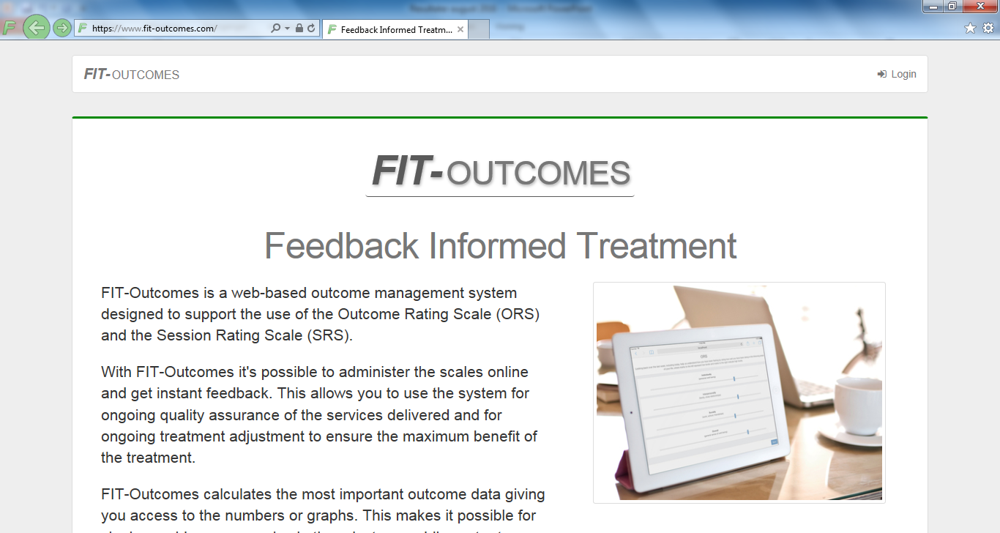

Slide 28
Results FIT 2016
473 clients – children and adults
Success rate: 66,2%
Drop-out: 8,4%
Average sessions: 5,8
Average months: 5,1

Slide 29

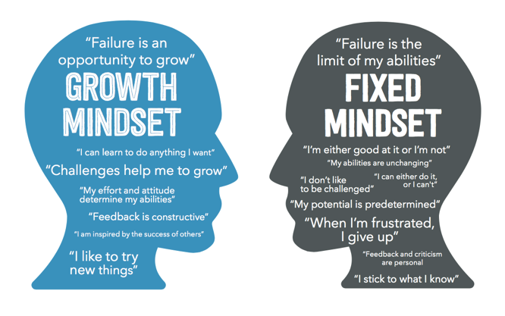


Challenges

Slide 30
