Slide 1


CORC Members’ Forum
November 2017
15 years of CORC: changing outcomes in a changing world?
#CORCforum

Slide 2
Plan for the day
10:30 – 11:00 | 15 years of CORC: changing outcomes in a changing world? | Professor Miranda Wolpert - Director, CORC
11:00 – 11:40 | How routine outcome monitoring feedback helps and hinders practice - the good, the bad and the ugly | Dr Kim De Jong - Assistant Professor, Leiden University
11:40 – 12:00 | Outcome monitoring: a young person’s perspective | Beth Ingram - Anna Freud Young Champion
12:00-12:20 | Developing a culture of routine outcomes measurement: transforming our approach to young person-centred support | Tessa Gregson - Head of Operations, 42nd Street
12:20 – 12:40 | Panel Q&A session
12:40– 13:30 | Networking lunch
13:30 – 14:10 | 15 years on: what has CORC learned from the data? | Julian Childs - Research Lead, CORC
14:10 – 14:30 | Three perspectives on outcome measurement: findings from the CORC evaluation | Dr Emily Stapley – Research Fellow, Evidence Based Practice Unit
14:30 – 14:50 | Current practice and perspectives towards routine outcome measurement: a survey of UK CAMHS services | Holly Bear – PhD Student, The Anna Freud National Centre for Children and Families
15:00– 15:20 | Coffee break
15:20 – 15:45 | Outcome led commissioning across the system: a work in progress | Alan Ford - Commissioning Business Manager for Children, Young People and Families, NHS Tameside and Glossop Clinical Commissioning Group
15:45 – 16:10 | Developing an outcomes based framework for children’s commissioning | Sheila McFarlane – Acting Deputy Head of Integrated Commissioning for Children and Young People, Derby Council
16:10 – 16:30 | Summary of the day and event close

Slide 3
Please submit your questions and comments for this morning’s presentations at
www.menti.com
Code: 56 39 56

Slide 4
A review of CORC research findings from 2012 - 2017
Dr Julian Edbrooke-Childs & Jenna Jacob
Research Leads
Notes:
Thanks
Welcome
Special as look back at work set out in first CORC forum

Slide 5
Contents
Overview of CORC Research agenda
Findings in relation to :
    How can we embed best practice in routine outcome monitoring and use of feedback?
    How do we best measure change in mental health over time?
    What is the impact of interventions/approaches on child mental health outcomes ?
    Who accesses services?
    How best to reflect on evidence about practice, and challenge orthodoxy when relevant?

Slide 6
CORC research agenda
We aim to:
  Understand the extent to which CYP’s care is helping them, and
  How real-world evidence can support and improve child and youth mental health services.
Once collected, we analyse data to assess:
  The impact of using outcome measures,
  The effectiveness and efficiency of services, and
  To answer key research questions.
Our work in this area comprises:
  Analysing members’ data and reporting to them on the findings.
  Evaluating mental health, wellbeing and other interventions.
  Carrying out analysis using CORC and other data sets to measure effectiveness, test hypotheses and discover new findings in order to generate evidence to underpin care.
  Collaborating with members and partners to conduct research.

Slide 7

CORC key research questions
  How can we embed best practice in routine outcome monitoring and use of feedback?
  How do we best measure change in mental health over time?
  What is the impact of interventions/approaches on child mental health outcomes ?
  Who accesses services?
  How best to reflect on evidence about practice, and challenge orthodoxy when relevant?

Slide 8
1. How can we embed best practice in routine outcome monitoring and use of feedback?

Slide 9

1a. Current practice
1/3 of CORC members reported use of outcome measures
Use of session-by-session measures was more likely with common problems e.g. mood & anxiety
Less likely with more complex cases, e.g. those in need of social service input or under state care.
  Goal formulation was more likely for
    pre-schoolers,
    those with learning difficulties, or
    those with both hyperactivity disorder and conduct disorder.
Edbrooke-Childs, J. H., Gondek, D., Deighton, J., Fonagy, P., & Wolpert, M. (2016). When is Sessional Monitoring More Likely in Child and Adolescent Mental Health Services? Administration and Policy in Mental Health and Mental Health Services Research, 43(3), 316-324. doi: 10.1007/s10488-016-0725-6.
Ford, T., Tingay, K., & Wolpert, M. (2006). CORC's survey of routine outcome monitoring and national CAMHS dataset developments: a response to Johnston and Gower. Child and Adolescent Mental Health, 11(1), 50–52.
Jacob, J., De Francesco, D., Deighton, J., Law, D., Wolpert, M., & Edbrooke-Childs, J. (2017). Goal formulation and tracking in child mental health settings: when is it more likely and is it associated with satisfaction with care? European Child & Adolescent Psychiatry. doi:10.1007/s00787-016-0938-y Considers if goal setting helps therapeutic outcomes.
Notes:
Who uses measures

Slide 10
1b. Barriers to use of ROMS
Clinicians and CYP in mental and physical health services reported concerns that PROMs could alter therapeutic discussions.
MH service users were concerned measures could alter the pace of clinical discussions at the expense of therapeutic relationships
Physical health service users were concerned that PROMs could direct clinical discussions away from physical health toward MH.
Similar barriers (and facilitators) to person centred care found in CAMHS and adult services:
  Information sharing/communication,
  Capacity of service users to be involved and
  Available resources.
  The main difference was related to a more complex role of a carer in children/young people services.
Wolpert, M., Curtis-Tyler, K., & Edbrooke-Childs, J. (2016). A Qualitative Exploration of Patient and Clinician Views on Patient Reported Outcome Measures in Child Mental Health and Diabetes Services. Administration and Policy in Mental Health and Mental Health Services Research, 43(3), 309-315. doi: 10.1007/s10488-014-0586-9.
Gondek, D., Edbrooke-Childs, J., Velikonja, T., Chapman, L., Saunders, F., Hayes, D., & Wolpert, M. (2016). Facilitators and barriers to person-centred care in child and young people mental health services: a systematic review. Clinical Psychology and Psychotherapy. doi: 10.1002/cpp.2052 review of Gleeson, H., Calderon, A., Swami, V., Deighton, J., Wolpert, M., & Edbrooke-Childs, J. (2016). Systematic review of approaches to using patient experience data for quality improvement in healthcare settings. BMJ Open. doi:10.1136/bmjopen-2016-011907

Slide 11

1c. Facilitators to use ROMS
Training and ongoing support facilitated implementing outcome monitoring at a service- and session-level.
Clinicians who reported higher levels of use of cognitive behaviour or humanistic approaches had higher levels of PROM use.
Clinicians who received training had higher levels of self-efficacy regarding PROMs.
Clinicians with more positive attitudes or self-efficacy regarding PROMs had higher levels of PROM use than clinicians with less positive attitudes or self-efficacy regarding PROMs.
.
Sharples, E., Qin, C., Goveas, V., Gondek, D., Deighton, J., Wolpert, M., & Edbrooke-Childs, J. (2016). A qualitative exploration of attitudes towards the use of outcome measures in child and adolescent mental health services. Clinical Child Psychology and Psychiatry. doi: 10.1177/1359104516652929
Edbrooke-Childs, J., Barry, D., Rodriguez, I., Papageorgiou, D., Wolpert, M., & Schulz, J. (in press). Patient reported outcome measures in child and adolescent mental health services: Associations between clinician demographic characteristics, attitudes, and efficacy. Child and Adolescent Mental Health.

Slide 12
1d. Changing professional behaviour
After training, supervisors had more positive attitudes to administering and using feedback from PROMs and higher levels of self-efficacy about using PROMs in supervision.
A key part of training was giving professionals time to consider how to use measures in a way that fits with their approach and their patients.
Training in how to use & interpret data from service users and use data to improve the quality of services was identified in a systematic review.
Edbrooke-Childs, J., Wolpert, M., & Deighton, J. (2016). Using Patient Reported Outcome Measures to Improve Service Effectiveness (UPROMISE): Training clinicians to Use Outcome Measures in Child Mental Health. Administration and Policy in Mental Health and Mental Health Services Research, 43(3), 302-308. doi: 10.1007/s10488-014-0600-2.
Fullerton, M., Edbrooke-Childs, J., Law, D., Martin, K., Whelan, I., & Wolpert, M. (2017). Using patient-reported outcome measures to improve service effectiveness for supervisors: a mixed-methods evaluation of supervisors' attitudes and self-efficacy after training to use outcome measures in child mental health. Child and Adolescent Mental Health. doi: 10.1111/camh.12206

Slide 13
2. How best to measure change in mental health over time?

Slide 14

2a. Determining best practice
Reviewed strengths and limitations of commonly used PROMs.
Explored how to analyse ratings of service satisfaction to inform the use of measures.
Examination of metrics of clinically meaningfully change – reliable change, clinical change and ‘added value’
scores – informed the development of our approach to analysing outcomes.
We are continuing to examine different ways of analysing change in mental health over time (e.g., network analysis).
Brown, A., Ford, T., Deighton, J., & Wolpert, M. (2012). Satisfaction in child and adolescent mental health services: translating users' feedback into measurement. Administration and Policy in Mental Health Mental Health Services Research. 41(4), 434–446.
Wolpert, M., Cheng, H. and Deighton, J. (2014). Review of four Patient Reported Outcome Measures (PROMs): SDQ, RCADS, C/ ORS and GBO: their strengths and limitations for clinical use and service evaluation. Child and Adolescent Mental Health. 20(1), 63–70.
Wolpert, M., Görzig, A., Deighton, J., Fugard, A.J.B., Newman, R. & Ford, T. (2014). Comparison of indices of clinically meaningful change in child and adolescent mental health services: different scores, reliable change, crossing clinical thresholds and 'added value' - an exploration using parent rated scores on the SDQ Child and Adolescent Mental Health. 20(2), 94–101.

Slide 16
  2b. Considering goals as outcome measures
  Our approach considers both standardised or normed measures (e.g., SDQ) and idiographic or personal measures (e.g., Goal Based Outcomes).
  We have undertaken research on collaboratively agreed goals as a key outcome metric
  We found that children and families tend to report higher levels of change in Goal Based Outcomes than in standardised measures.
  Change in Goals was more consistently associated with change in clinician-reported measures – and with satisfaction with care at case closure – than standardised measures.
  We have published a series of papers analysing the types of goals young people and parents set in the early stages of therapy
    We produced a taxonomy of the different types of goals.
  Jacob, J., Edbrooke-Childs, J., Law, D., & Wolpert, M. (2015). Measuring what matters to patients: using goal content to inform measure choice and development. Clinical Child Psychology and Psychiatry. 22(2), 170–186.
  Edbrooke-Childs, J., Jacob, J., Law, D., Deighton, J., & Wolpert, M. (2015). Interpreting standardized and idiographic outcome measures in CAMHS: what does change mean and how does it relate to functioning and experience? Child and Adolescent Mental Health. 20(3), 142–148.
  Bradley, J., Murphy, S., Fugard, A. J. B., Nolas, S-M. & Law, D. (2013). What kind of goals do children and young people set for themselves in therapy? Developing a goals framework using CORC data. Child and Family Clinical Psychology Review, 1, 8–18.
Notes:
How goals can inform measure use

Slide 17
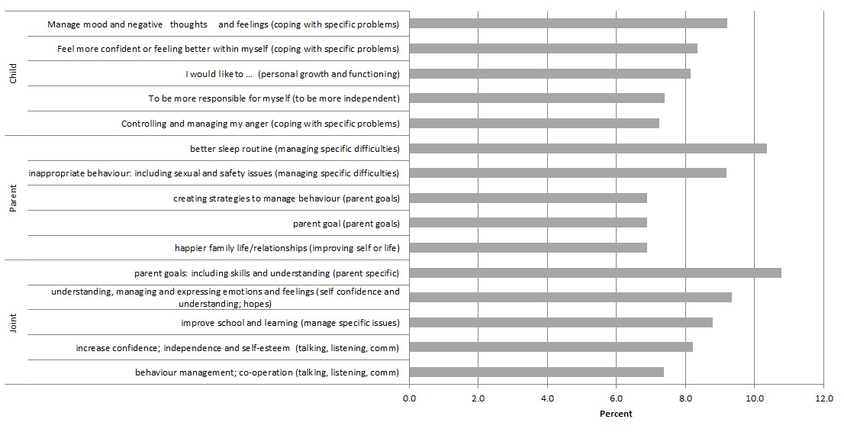
2b. Considering goals
Figure 1. Top five goals themes from each perspective N=342 (overarching goals are in parenthesis)
Jacob, J., Edbrooke-Childs, J., Holley, S., Law, D., & Wolpert, M. (2015). Horses for courses? A qualitative exploration of goals formulated in mental health settings by young people, parents and clinicians. Clinical Child Psychology and Psychiatry. 21(2), 208–223. Comparing goals set by children, parents and clinicians
Notes:
Coping with specific problems
Personal growth
Improving self and quality of life
Talking, listening and communication

Slide 18
3. Evaluating the impact of interventions

Slide 19

3a. Impact of use of ROMS
In a systematic literature review we found over half of 32 studies reviewed, CYP had improved levels of outcome when they or their clinician could view feedback from measures.
Feedback was particularly effective for CYP not responding to treatment as expected and when it was provided to both clinicians and CYP
Gondek, D., Edbrooke-Childs, J., Fink, E., Deighton, J., & Wolpert, M. (2016). Feedback from Outcome Measures and Treatment Effectiveness, Treatment Efficiency, and Collaborative Practice: A Systematic Review. Administration and Policy in Mental Health and Mental Health Services Research, 43(3), 325-343. doi: 10.1007/s10488-015-0710-5.

Slide 20

3b. Impact of “best practice” routine care; CYP IAPT data
Reliable improvement at end of treatment (scores improved more than likely due to measurement error) based on self report.
  53% for those with anxiety,
  44% for those with depression,
  35% for those with comorbid depression and anxiety.
  NB 52% of all and 10% deteriorated
We are continuing to analyse these data to examine group differences in reliable improvement (e.g., by needs-based groups).
Edbrooke-Childs, J.,* Wolpert, M.,* Zamperoni, V., Napoleone, E, , Bear, H. (In preparation circulated to CPRU group and DH) Majority of adolescents with depression and anxiety not reliably improved at end of treatment: What should we tell the children?
Notes:
Reliable change in those not accessing services

Slide 21

3c. Impact of “evidence based” practice
    CBT for anxiety and depression was found to be more effective than non CBT interventions.
    No evidence of better outcomes was found for parenting for behavioural difficulties as opposed to other interventions.
    Deighton, J., Argent, R., De Francesco, D., Edbrooke-Childs, J., Jacob, J., Fleming, I., Ford,T., & Wolpert, M. (2015). Associations between evidence-based practice and mental health outcomes in child and adolescent mental health services. Clinical Child Psychology and Psychiatry, 21(2), 287-296. doi: 10.1177/1359104515589637.

Slide 22

3d. Impact of shared decision making
Child- and parent-reported experience of shared decision making were associated with higher levels of improvement in psychosocial difficulties.
Edbrooke-Childs, J., Jacob, J., Argent, R., Patalay, P., Deighton, J., & Wolpert, M. (2015). The relationship between child- and parent-reported shared decision making and child-, parent-, and clinician-reported treatment outcome in routinely collected child mental health services data. Clinical Child Psychology and Psychiatry, 21(2), 324-338. doi: 10.1177/1359104515591226

Slide 23

3e. Impact of service and population variation
4-5% service-level variation in treatment outcome.
CYP with autism and those with infrequent case characteristics which required more specialised input (e.g., substance misuse) were associated with a poorer treatment outcome.
Edbrooke-Childs, J., MacDougall, A., Hayes, D., Jacob, J., Deighton, J., & Wolpert, M. (2017). Service-level variation, patient-level factors and treatment outcome in those seen by child mental health services. European Child & Adolescent Psychiatry. doi: 10.1007/s00787-016-0939-x

Slide 24
4. Who is accessing services?

Slide 25
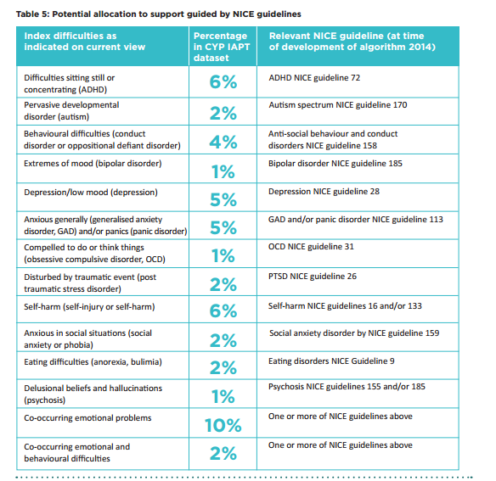
7. Considering Service Use: Work progress Wolpert et al
  4a Case Mix of those seen in services
28% of CYP had mild problems or one moderate that doesn't fit NICE guidance.
25% of CYP had multiple or severe problems that don’t fit easily into NICE guidance.
Martin, P., Davies, R., Macdougall, A., Ritchie, B., Vostanis, P., Whale, A., & Wolpert, M. Developing a case mix classification for child and adolescent mental health services: the influence of presenting problems, complexity factors, and services on number of appointments. Considers impact of problems and complexity factors on service use
Notes:
n = 31,037 cases ; current view completed within 56 days of the recorded start of therapy .

Slide 26

  4b. Impact of ethnicity on access routes
BAME groups were less likely to access specialist help via primary care than White British.
BAME groups were more likely to be referred by social care or education than White British.
Edbrooke-Childs, J., Newman, R., Fleming, I., Deighton, J., & Wolpert, M. (2015). The association between ethnicity and care pathway for children with emotional problems in routinely collected child and adolescent mental health services data. European Child & Adolescent Psychiatry, 25(5), 539-546. doi: 10.1007/s00787-015-0767-4.
Notes:
Re examining using up to date data taking into account deprivation and service differences

Slide 27
  4c. Are services seeing more troubled young people
Services are seeing more difficulties (2009→2014) particularly in relation to emotional problems for girls.
This mirrors the epidemiological picture.
However, where difficulties are reducing, e.g. conduct disorders, it appears thresholds reduce too.
  So it is important services review thresholds to ensure best use
Edbrooke-Childs, J., Deighton, J., & Wolpert, M. (2017). Changes in severity of psychosocial difficulties in adolescents accessing specialist mental healthcare in England (2009–2014). Journal of Adolescence, 60, 47-52. doi: 10.1016/j.adolescence.2017.07.006

Slide 28
5. How best to reflect on evidence about practice, and challenge orthodoxy when relevant?

Slide 29
5a. Using data for improvement
  Published several leading edge articles on our innovative approach to supporting services in the collection, analysis and use of outcome data
  Particular focus on interpreting the data within a local service context to help draw out learning for continuous quality improvement
  Wolpert, M., Deighton, J., De Francesco, D., Martin, P., Fonagy, P., & Ford, T. (2014). From 'reckless' to 'mindful' in the use of outcome data to inform service-level performance management: perspectives from child mental health. BMJ Quality and Safety. bmjqs-2013. Offers approach to using data to inform quality improvement
  Fleming, I., Jones, M., Bradley, J. & Wolpert, M. (2014). Learning from a learning collaboration: The CORC approach to combining research, evaluation and practice in child mental health. Administration and Policy in Mental Health and Mental Health Services Research. 43(3), 297–301. Summary of CORC approach
  Edbrooke-Childs, J., Wolpert, M., & Deighton, J. (2016). Introduction to the Special Section on Implementing Feedback from Outcome Measures in Child and Adult Mental Health Services. Administration and Policy in Mental Health and Mental Health Services Research, 43(3), 277-278. doi: 10.1007/s10488-016-0726-5. Considers approach to using ROM

Slide 30


5b. championing use of FUPS data
Flawed
Uncertain
Proximate
Sparse
Notes:
The data are not perfect, far from it. They are:
Flawed, due to some being missing or erroneously recorded (in this report the high degree of missing data is stressed throughout);
Uncertain, in part due to differences in the perspectives of those recording the information;
Proximate, in that proxies for outcome and impact are considered; and
Sparse, in that low volumes of key subgroups limit our ability to reliably extrapolate.
Despite the challenges, the findings are based on the best data currently available and CORC believe they should be used carefully to support dialogue about outcomes.

Slide 31
5c leading narrative on new ways of thinking about how best to intervene
  Leading the field in starting to think about how to consider the limits of therapy, possible unintended harmful consequences and consider discussions in relation to
  a) Endings
  b) Self-management/ support in the absence of a mental health professional
  We are increasing focussed on early intervention and work in schools
  Wolpert, M., Deighton, J., Fleming, I. & Lachman, P., (2014). Considering harm and safety in youth mental health: A call for attention and action. Administration and Policy in Mental Health and Mental Health Services Research. 42(1), 6–9.
  Bickman, L., Lyon, A. & Wolpert, M. (2016) Achieving Precision Mental Health through Effective Assessment, Monitoring, and Feedback Processes Introduction to the Special Issue. Administration and Policy in Mental Health and Mental Health Services Research. doi: 10.1007/s10488-016-0718-5

Slide 32
A review of CORC research findings from 2012 - 2017
Dr Julian Edbrooke-Childs & Jenna Jacob
Research Leads

Slide 33
Please submit your questions and comments for this afternoon’s presentations at
www.menti.com
Code: 68 10 74

Slide 34
Thank you for attending
We would be grateful for your feedback
Visit menti.com and use code 10 49 20
to fill out our evaluation form

