Slide 1

Developing a culture of routine outcomes measurement: transforming our approach to young person-centred support.
Tess Gregson, Head of Business Operations
November 2017

Slide 2
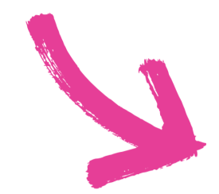

42nd Street’s vision, mission & objectives…
Our Mission
To support young people with their emotional well-being and mental health, promoting choice and creativity. We champion young person centred approaches that demonstrate local impact and have national significance.
“Inclusive accessible mental health services for all young people”
Our Social objectives:
Improve well-being and recovery
Increase opportunities for young people to shape their own care and influence change
Improve and increase inclusion and accessibility to services and support
Increase awareness and reduce stigma

Slide 3

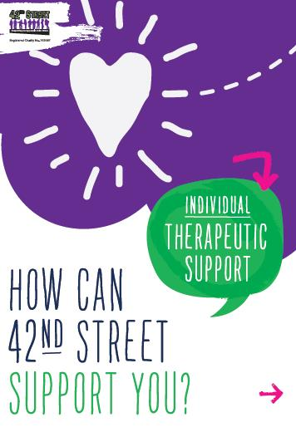
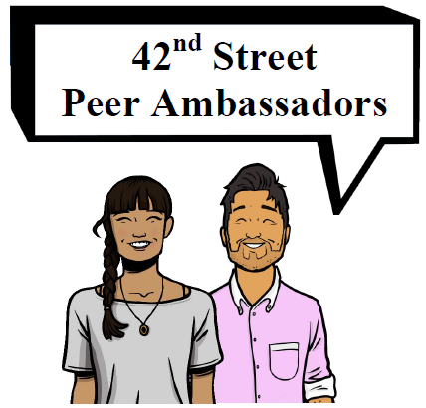
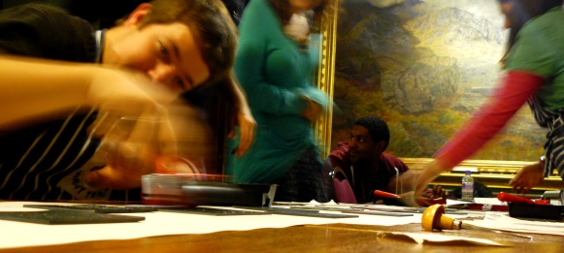

42nd Street Services
One to one counselling, therapy, psycho-social support and advocacy Therapeutic, issue based and identity based groups and peer support projects The Horsfall creative programme Residentials and Getaways A Social Action Programme Bespoke services in schools, PRUs, colleges and universities Training programmes for professionals Collaboration with partners.

Slide 4
Our journey
Pre-2010:
Qualitative data only – support reviews, etc.
2010-11:
Research, consultation, pilot – SDQ? YP-CORE? WEMWBS? GAD-7? PHQ-9?
Consultations with staff, trustees and young people.
2012/13:
1st year YP-CORE service wide / review / analysis
2014/15:
One Low Intensity and One High Intensity CBT trained staff. First use of IAPT measures in-service (no data submitted)
2015/16:
Development of IAPT compliant services; 1st submission of IGT (L2)
(Q4) 1st submission of CAMHS dataset to CORC as part of the Tameside & Glossop data project led by T&G CCG (VCSE and CAMHS partners)

Slide 5
Our journey
2015/16:
Young People in Mind (YPIM) national VCSE research project with Youth Access: young people in transition (16-19s) and the impact of VCSE YIACS.
2016/17:
YPIM complexities dataset informs development of new charity dataset. Implementation of new service model and monitoring and evaluation systems/processes.
Two further staff High Intensity CBT trained; submitting the national Adult IAPT dataset
Contributing to local transformation plans (LTPs) and relevant evidence of impact.
2017/18:
Counselling service complete Counselling for Depression training; 1 EMDR trained. (2.6 FTE IAPT team)
42nd Street leads M&E on behalf of the Integrated Community Response Service (ICRS) (Manchester and Salford CCGs) working with partners across the health and social care system: offering de-escalation interventions to ensure young people access crisis support at the right time, in the right setting, by the right service. Submission of the national CAMHS MHMDS.

Slide 6
Routine Outcomes Measures, 2017
Service | Assessment | Ongoing therapeutic support | Final measures | Satisfaction with services
Manchester, Salford and Trafford CCG services | YP-CORE (Initial + Goal Attainment) IAPT minimum dataset (18+ yrs) Charity dataset | YP-CORE (Ongoing) – reviewed and repeated at regular intervals) Qualitative review of support | YP-CORE (Final) Goal Attainment + service review elements) | NHS Friends and Family test (F&F) PEQ 1 (waiting times and assessment) PEQ 2 ‘Support’
IAPT services (individual & group therapy) | As above (one assessment route for all yp) | Session by session ROMs – Adult IAPT min. dataset (+ disorder specific measures) | Adult IAPT min. dataset | PEQ 1 PEQ 2 NHS Friends & Family Test
Tameside & Glossop CCG |  | Session / session ROMs: GBO (C)ORS (C)SRS | GBO (C)ORS (C)SRS | Experience of Service Questionnaire F&F
ICRS |  | CAMHS MHMDS | CAMHS MHMDS | ESQ F&F

Slide 7
Our approach
Collaborative leadership
Involve young people – formal and informal opportunities
Clarity of purpose and a clear workplan
Effective project management: pitfalls of small tweaks vs. decisive action
Strong comms strategy – communication is key
Lead roles and opportunities to volunteer expertise/interest: working parties: whole organisation approach creates buy-in across the team
Principle of ‘early adopters’ – understand what makes team members tick and why…this enables you to address fears and find the right approaches.
Pilot and review
Champions – peer learning is invaluable – dispelling myths, sharing learning and informal teaching, support
Make feedback routine: celebrating success and focusing attention on developmental areas (whole team, service and supervision spaces).

Slide 8

Challenges & Opportunities - internal
Differing staff experiences/perceptions of ROMs
Professional training: ‘routine’ approach; ‘evidence based’
Fears: challenge to professional judgement; scrutiny on practice
Young person-centred?
Individual responses to change / management skills: change management
Significant systems change: IT, service model, dataset, forms and templates.
Financial implications and capacity
Champions and early adopters
Up-skilling and growing talent –
HEE funded training
Greater agility and ability to influence externally
Value of external support – system partners, systems expertise – LSF, King’s Fund, Pilotlight.

Slide 9
Challenges and Opportunities – Wider system
Future in Mind / Five Year Forward View: Young people’s services up to 25 yrs – implications for transition and consistency of care.
National datasets: child development vs. numeric age – system catch up
National datasets do not reflect diversity of identities or complexity of experiences impacting on mental health and wellbeing
Research & development: learning disabilities, ASD & Autism.
GM Devolution – local, evidence based solutions that genuinely work for people – replication?
Consistency – use of comparable datasets across sectors (Development of the Greater Manchester CAMHS Spec)
N3 vs. HSCN and wider local, regional and national connected data projects – drive towards collaboration and connection across the health and social care, education and criminal justice system.
Online services: national guidance, GDPR, online child bill of rights…

Slide 10
Benchmarking our Impact
BACP research (c. September 2015) results:
Score +5 increase in YP-CORE score = 5% deterioration
No change 51% (move <5 pts or less)
44% reliable improvement (5 or more points)
2015/16: CORC Membership: seeking to benchmark nationally
2017/18: Ongoing focus on improving outcomes and completion rates.
2017/18: Commissioning of new management information system to manage multiple data streams.

Slide 11
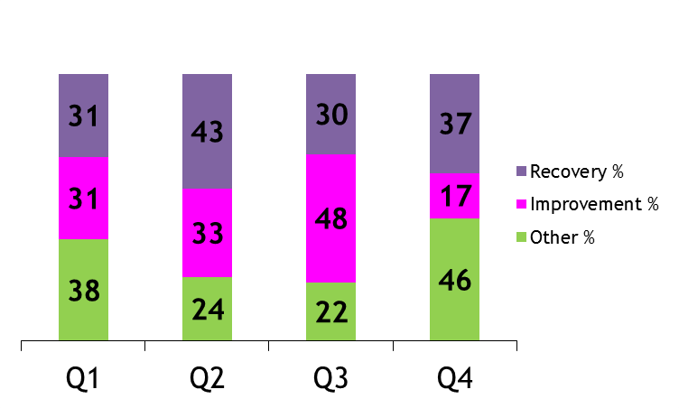
Recovery rates 2016/17
56%
Salford CCG
DNA rates: 5-13% charity-wide
Consistently high “reliable change” and “reliable recovery” rates for individual therapeutic work (2016/17)
63%
Trafford CCG
Manchester CCG
Outcomes data is nationally benchmarked by Child Outcomes Research Consortium (CORC). In Tameside & Glossop (2016/17), young people showed 2x the reduction in their Outcomes Rating Scale scores than was seen in the ‘rest of CORC’ services.

Slide 12
What are young people telling us?
At the End of Support:
“The therapy is changing my life… I’m no longer experiencing flashbacks or nightmares.”
“Thank you.”
“Very helpful - I feel so much happier with life and myself. The support was so helpful and fantastic.”
“CBT has helped me take control as a person who used to worry considerably.”
“When I first arrived I felt like the support had already started as every member of staff I spoke to was kind and caring. From the beginning support induction with [the practitioner]… she took into account my feelings and what I needed help with to the start of my 121 support. [The practitioner] has helped me find coping mechanisms I never knew I had.”
98.5 %
Young People would recommend 42nd Street to friends & family (charity-wide, 2016/17)

Slide 13
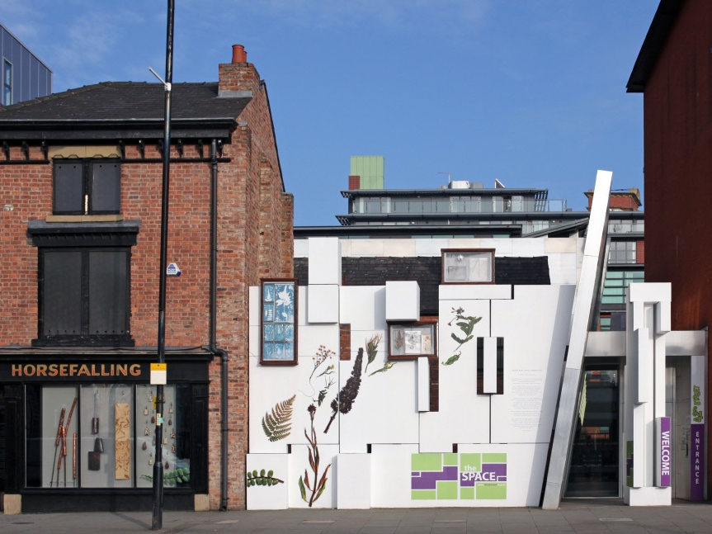
Get in touch!
42nd Street
The Space
87-91 Great Ancoats Street
Manchester
M4 5AG
0161 228 7321 www.42ndstreet.org.uk
@42ndStreetmcr
@TheHorsfall

