Slide 1


Outcome Led Commissioning Across the System:
A work in progress
Alan Ford
Greater Manchester FIM Commissioner Lead | Children, Young People & Families Commissioning Manager
Greater Manchester Health & Social Care Partnership | NHS Tameside and Glossop Clinical Commissioning Group
4th Floor | 3 Piccadilly Place | Manchester | M1 3BN | Hattersley Hub | Stockport Road | Hyde | SK14 6AF
http://www.gmhsc.org.uk | http://www.tamesideandglossopccg.org/
Email: alan.ford4@nhs.net

Slide 2
Moving to Outcomes
The question of whether to monitor outcomes, or not, is no longer in debate – we must use them to ensure good services continue to be commissioned and to support arguments to bring new money into CAMHS ( Law, D. 2014)

Slide 3
The Journey To An Outcomes Framework
2015-2016 CAMHS KPIs
CAMHS Admissions to Adult Wards
Activity referral data
2015-2016 Voice of the Child Consultation
Quality standards were developed through consultation and focus groups with CYP
Measures were agree with Clinicians and steering group
2016-17 Cross system outcome framework piloted
Initial partners include Education and ChS Social Care
2017-18 Outcome framework is being mirrored in Pan-GM spec
Developed and going through governance for ratification

Slide 4
i
I should be listened to, given time to tell my story and feel like what I say matters
I want my situation to be treated sensitively and I should be respected and not feel judged
I want the professionals that I come into contact with to be kind and understanding and realise that I need to trust them if they are going to help me
I should always be made to feel safe and supported so that I can express myself in a safe environment
I should be treated equally and as an individual and be able to shape my own goals with my worker
I want my friends, family and those close to me to understand the issues so that we can support each other
I want clear and up to date detailed information about the services that I can access
I want to get the right type of help, when things first start to be a problem, at the right time in the right place and without having to wait until things get worse
I want to feel that services are shaped around my needs and not the other way round, but I also want to know that I am not alone in how I am feeling
I want my support to feel consistent and easy to find my way around, especially if I need to see different people and services

Slide 5
Our Approach
Cross-system working group explored balancing ‘what do we need to know’ with ‘why do we want to know it’ and then ‘what can we do with it’?
Underpinning consideration: ‘our service is effective and value for money’
‘Coproduction and collaboration’: Commissioners and Providers must ensure that services for CYP places them at the heart of everything we do
Assurance for commissioners
Can we keep it simple whilst being fit for purpose?

Slide 6
5 Key Domains
Ensure goals-orientated interventions that hold the voice of the CYP at the heart
Provide a voice for what the experts by experience say about the support
Support clinical development - for the individual and the practitioner
Support service development
Assure commissioners and inform future commissioning
Notes:
Went away reviewing seeking to learn from other where is the evidence informed practice is, and develop the buy-in and gather the right people – nod to Corc

Slide 7
Future In Mind
“All services give you the opportunity to set your own
treatment goals and will monitor with you how things are going. If things aren’t going well, the team providing your care will work with you to make changes to achieve your goals. You have the opportunity to shape the services you receive. That means listening to your experience of your care, how this fits with your life and how you would like services to work with you. It means giving you and those who care for you the opportunity to feedback and make suggestions about the way services are provided”.

Slide 8
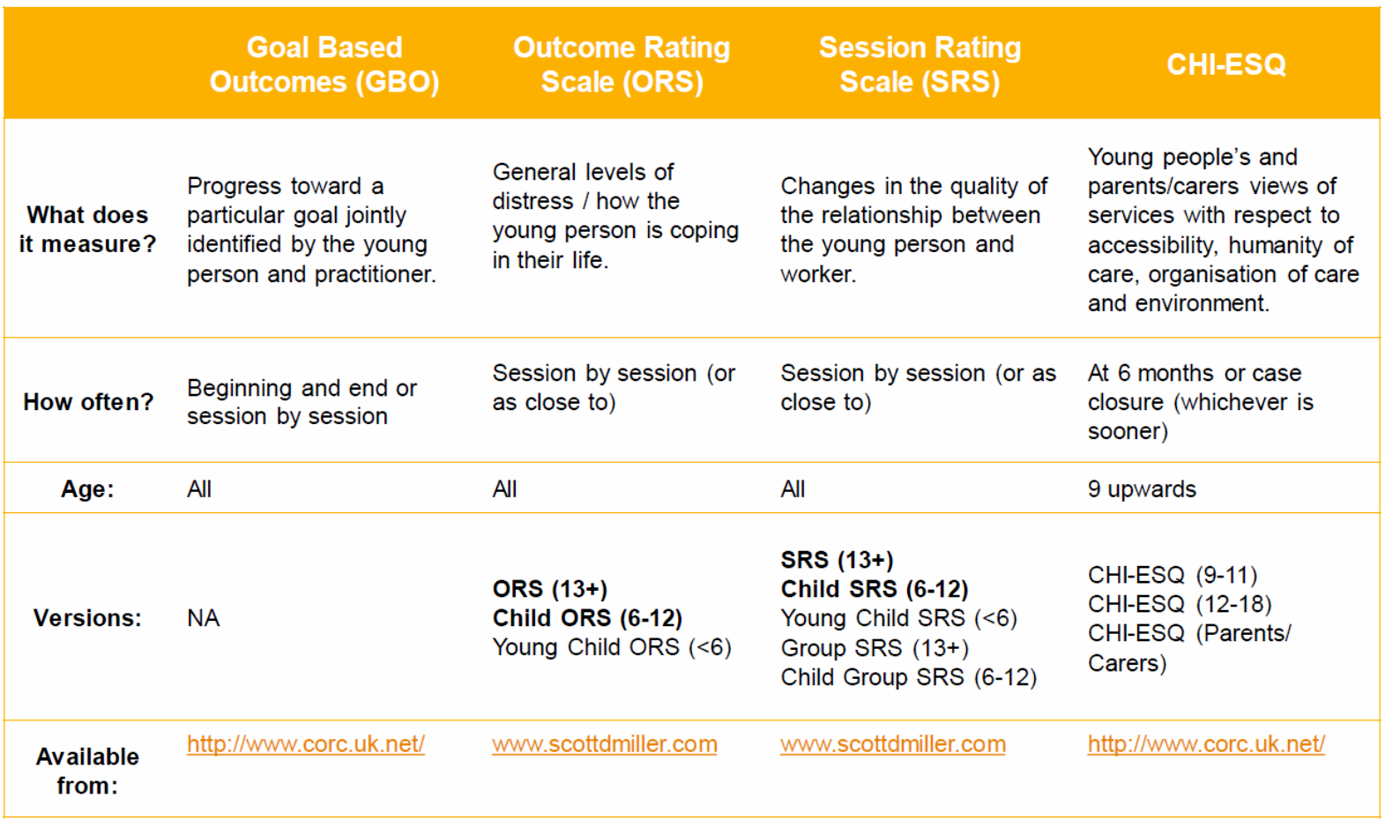
The Core Measures

Slide 9
Goal Based Outcomes (GBO)
Applicable to all interventions
Measure progress toward a goal that has been jointly agreed by the young person and worker.
Helps to build a helping relationship/strong therapeutic alliance
  Helps track the specific goals the CYP wants to address
  Tool to aid and focus discussion
  All parties are clear about what the agreed focus of the intervention is
Help to formulate the end of treatment ad support
*slide adapted from CORC training

Slide 10
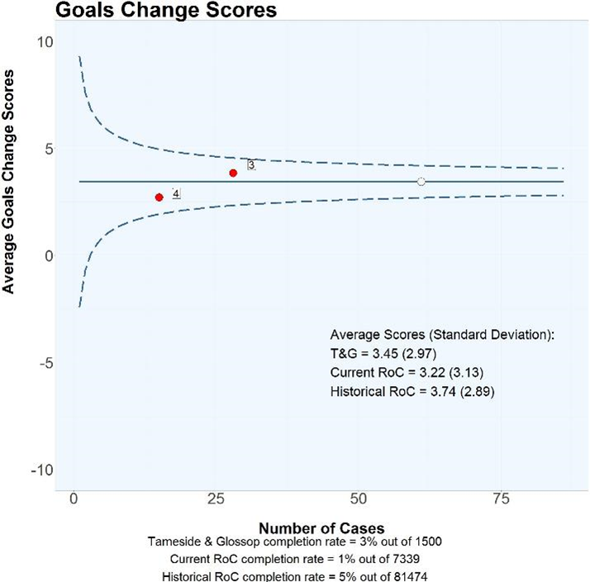
How have Goals scores changed between a first and last time point?
What do the plots show?
GBO measures bespoke goals of treatment, on a scale of 0 to 10 (higher scores indicating being closer to achieving the goals set). The blue line represents the overall average change score for services who submitted paired GBO data during the reporting period. The overall average change score for T&G services is around 3, similarly to rest of CORC.

Slide 11
Outcome Rating Scale (ORS) and Session rating scale (SRS)
Often used in conjunction with each other
Applicable to all direct work
Can be applied session by session
ORS and SRS gives CYP a voice in treatment as it allows them to provide immediate feedback on what is working and what is not.
ORS is a simple, four-item session by session measure designed to assess areas of life functioning known to change as a result of therapeutic intervention
SRS designed to assess key dimensions of effective therapeutic relationships (respect and understanding, relevance of the goals and topics, CYP-practitioner fit and overall alliance).
*slide adapted from CORC training

Slide 12
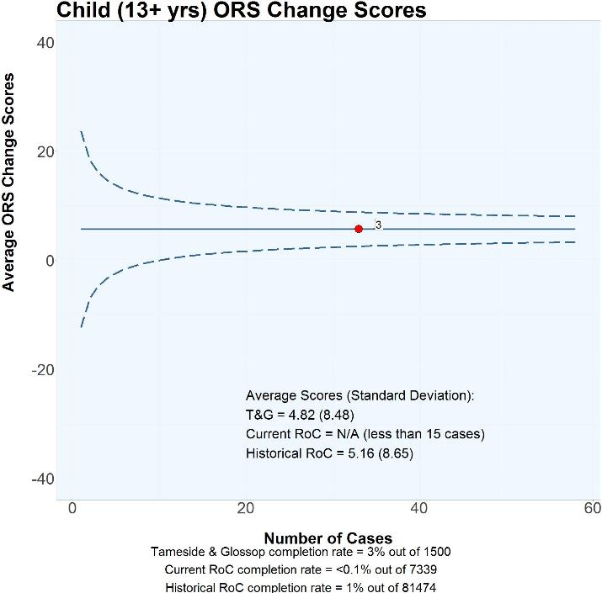
How have child-reported (13+) ORS scores changed between a first and last time point?
What do the plots show?
ORS measures overall well-being and relationship quality, on a scale of 0 to 40 (higher scores indicating better well-being). The blue line represents the overall average change score for service who submitted paired data during the reporting period. Overall average change score for the T&G service is around 5 indicating CYP seen for whom we have data appear to improve in overall well-being from a first to a last time point.
Notes:
The ORS measures overall well-being and relationship quality, on a scale of 0 to 40 (higher scores indicating better well-being).

Slide 13
CHI-ESQ
Experience of service feedback questionnaire
12 items
Parent and Self-Report (9-18yrs)
Gives indication of satisfaction with service
Additional free text questions allow for collection/ analysis of qualitative data alongside quantitative responses
Collected at 6 months or case closure (whichever is sooner); then annually if still in service

Slide 14
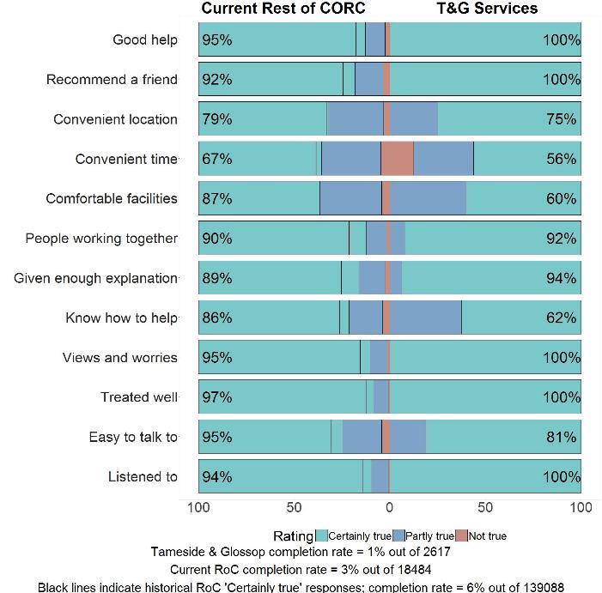
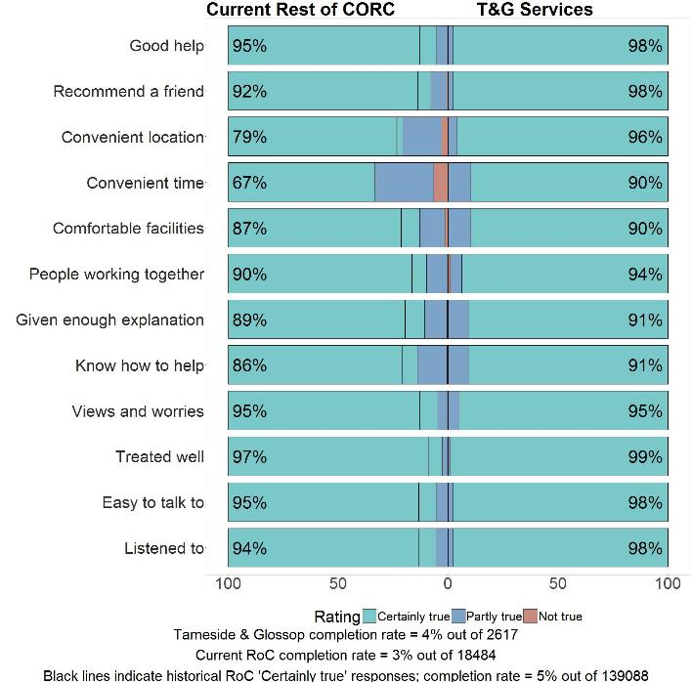
What Children and families are saying about the services?
How do children and young people How do parents and carers feel
feel about the services? about the services?

Slide 15
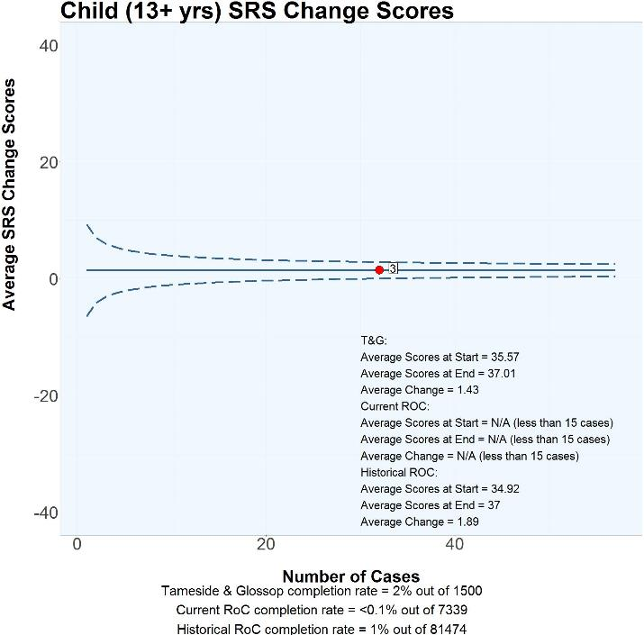
How have child-reported (13+) SRS scores changed between first and last time point?
What do the plots show?
The measures of therapeutic alliance, on a scale of 0 to 40 (higher scores indicating better alliance.) The blue line represents the overall average change score for the only service who submitted paired SRS data during the reporting period. The overall average change score for the T&G service included in the plot is around 1, bringing the average score at a last time point to a level that suggests good therapeutic alliance (37; Bargmann & Robinson, 2012).

Slide 16
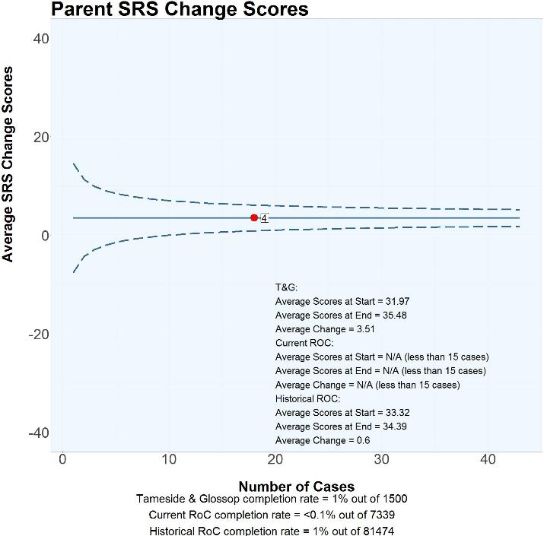
How have parent-reported SRS scores changed between a first and last time point?
What do the plots show?
The blue line represents the overall average change score for the only service who submitted paired SRS data during the reporting period. The overall average change score for the T&G service included in the plot is around 3, bringing the average score from 32 at a first time point, to 35 at a last time point, a level that suggests “cause for concern” in terms of therapeutic alliance (below 37; Bargmann & Robinson, 2012). Parents/carers of children and young people seen in T&G services for whom we have data report improvements in therapeutic alliance from a first to a last time point, although scores remained below the range of scores that indicate good alliance.

Slide 17
Outcome Framework

Slide 18
Where are we now…
Emerging and growing evidence indicating that services are:
establishing good therapeutic alliance – vital in helping recovery
helping CYPF to recover together and demonstrating effective services
aiding CYPF to progress towards their self-identified goals
offering a positive experience according to CYP and parent feedback
WE ARE COLLABORATIVELY ASKING OURSELVES BETTER AND MORE INFORMED QUESTIONS!

Slide 19
Future Considerations…
Focus on vulnerability - applying ‘Current View’ piloting LAC and then those connected with the youth system
Improve data flow
Benchmarking with like services with similar demographics
Widening to other partners
Phased developed across all GM NHS CAMHS providers 2018/19 and beyond

Slide 20

Questions…?

