Slide 1
Take aways from the most recent research on measuring improvement using the Goal-based outcomes tool (GBO)
Recent research – clinical implications/use
Goal setting with young people for anxiety and depression: What works for whom in therapeutic relationships?
Working with Goals and Trauma in Youth Mental Health
Goal-based measurement in paediatric settings
Recent research – psychometric properties
Test–retest stability, convergent validity, and sensitivity to change for the Goal-Based Outcome tool for adolescents

Slide 2
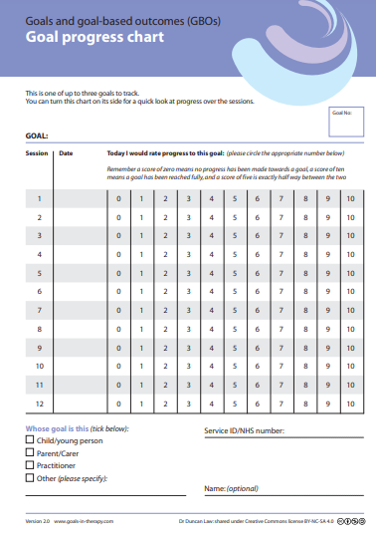
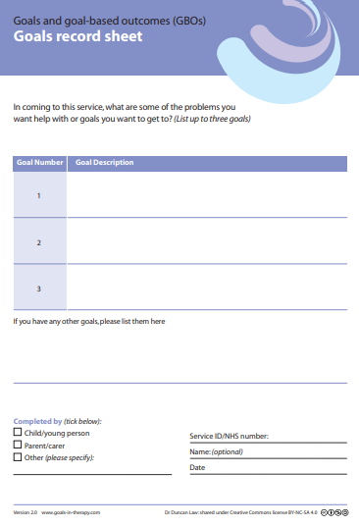
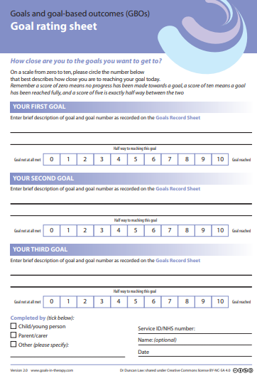
GBO
https://www.corc.uk.net/outcome-experience-measures/goal-based-outcomes-gbo/
https://goals-in-therapy.com/goals-and-goals-based-outcomes-gbos/

Slide 3
Goal setting with young people for anxiety and depression: What works for whom in therapeutic relationships?
Jacob et al., (2022)
Mixed methodological approach
1) reviews of:
peer-reviewed literature
grey literature
additional sources
2) consultation with experts with lived experience and professionals in the field
Reviewed over 10,000 articles and sources of information
Resultant sample of relevant sources was N=7

Slide 4
Goal setting with young people for anxiety and depression: What works for whom in therapeutic relationships?
Clinical implications
Findings – in summary
Support for goal setting = overwhelmingly positive
  ✓ Shared language
  ✓ Shared understanding
  ✓ Common ground
  ✓ Builds trust
Flexibility
Ownership of goals
Limiting factors:
  High levels of distress
  Experience of trauma
  Long term therapy contexts

Slide 5
Working with Goals and Trauma in Youth Mental Health
Law, (2022)
Opinion paper
Goals work

Slide 6
Goal-based measurement in paediatric settings
Jacob et al., (2022)
Reflective commentary
 likelihood of mental health difficulties in young people with chronic health conditions
Physical health and quality of life outcomes often prioritised
Outcomes ≠ to physical symptoms might be missed
What recovery means to young people may be very nuanced
    Case examples
    Example wording to help set and work on goals
    Tips for paediatricians

Slide 7
Test–retest stability, convergent validity, and sensitivity to change for the Goal-Based Outcome tool for adolescents
Duncan et al., (2022)
In summary – child rated GBO
Most correlated with measures of general wellbeing and self-esteem
Least correlated with the SDQ subscales
More sensitive to individual change than standardised measures, e.g., YP-CORE
GBO scores stable over between 6 and 24 weeks
Child-rated GBO “meaningful change” criterion of 3 points

Slide 8
Summary of implications for practice
New findings with key take aways
  Encouraging for the continued use of the GBO tool
  Case examples, suggested wording and ideas for support in the use of the GBO tool

Slide 9
References
Duncan, C., Cooper, M., & Saxon, D. (2022). Test–retest stability, convergent validity, and sensitivity to change for the Goal-Based Outcome tool for adolescents: Analysis of data from a randomized controlled trial. Journal of Clinical Psychology. 1–14. https://doi.org/10.1002/jclp.23422
Law, D. (2022). Working with Goals and Trauma in Youth Mental Health. International Journal of Environmental Research Public Health. 19(17). 11048, https://doi.org/10.3390/ijerph191711048
Jacob, J., Edbrooke-Childs, J., Flannery, H., Segal, T. Y., & Law, D. (2022). Goal-based measurement in paediatric settings: implications for practice. Archives of Disease in Childhood. http://dx.doi.org/10.1136/archdischild-2021-322761
Jacob, J., Stankovic, M., Spuerck, I., & Shokraneh, F. (2022). Goal setting with young people for anxiety and depression: What works for whom in therapeutic relationships? A literature review and insight analysis. BMC psychology, 10(1), 1-15. https://doi.org/10.1186/s40359-022-00879-5

