Slide 1
CORC Forum 2022
CORC Update
Kate Dalzell, Head of CORC

Slide 2
Introduction
Developments at CORC
Some of our new learning and approaches
A couple of things to look out for…
Title

Slide 3
About CORC
The Child Outcomes Research Consortium (CORC) brings together organisations and individuals committed to using and improving evidence to improve children and young people’s mental health and wellbeing.
Founded in 2002 by a group of mental health professionals determined to understand the impact of their work, today our network includes mental health providers, education settings, cultural and community services, local authorities, professional bodies and research institutions from across Europe and beyond.
Notes:
CORC’s vision is for all children and young people’s wellbeing support to be informed by real-world evidence so that every child thrives.
Our mission is to promote the meaningful use of evidence to enable more effective child-centred support, services and systems to improve children and young people’s mental health and wellbeing.

Slide 4
We believe..
… we can improve child and youth mental health services by using real-world evidence and understanding the extent to which children and young people’s care is helping them.
… everyone who offers support to children and young people should collect and use evidence as part of their day-to-day work.
… the voices of children, young people and their parents and carers are essential in generating and using this evidence to good effect.
… that by carrying out research, sharing learning, and acting on this, together we can improve the support available to children and young people (and help them to thrive).

Slide 5
1. A learning collaboration to develop outcome measurement in child and youth mental health
A place go for advice and dialogue about outcome measurement
Access to outcome measures, guidance and resources
learning from others
Training
to improve experiences of measuring outcomes, and to get the best value from it
Events
to share and explore new research and innovation
Developing and promoting participative and inclusive approaches
Translating research for practitioners to use
Notes:
Enquiring, analysing and supporting at different levels..
Clear rationale for your approach and measurement plan (logic models and Theories of Change)
Advising organisations on how to use and interpret information they have collected about mental healthCarrying out analysis for organisations, using our expertise in analysing and interpreting
Carrying out research to deepen knowledge of child and youth mental health (and what supports it)Surveys and reports for understanding the wellbeing and support needs of pupils and staff in schools and colleges: simple approach and robust comparisons

Slide 6
Hands-on advice and help:
To understand mental health and wellbeing needs
Best practice in systems for routinely monitoring outcomes and experience
To engage those accessing services in how we improve
To choose and use the right measures, in the right way
To measure the impact of your support
To share and talk about outcome information - and decide how to act
Notes:
An anonymous survey was completed by 184 CAMHS practitioners in the United Kingdom. The survey was designed using the Capability, Opportunity, and Motivation Model of Behaviour (COM-B). Practitioners who reported using ROM frequently in their clinical work (53%) were compared to those who used ROM infrequently (47%) across dimensions of the COM-B survey subscales.
Best practice survey -
Frequent users of ROM exhibited significantly higher psychological capability, physical opportunity, social opportunity, and motivation, compared to infrequent users
- Does demonstrateg

Slide 7
2. Developments at CORC
Title

Slide 8
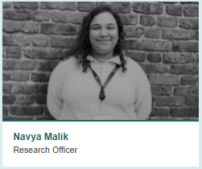
Welcoming new staff…
Title

Slide 9
Saying goodbye to our
fantastic CORC Board
And welcoming in a new
CORC Advisory Group
Title

Slide 10
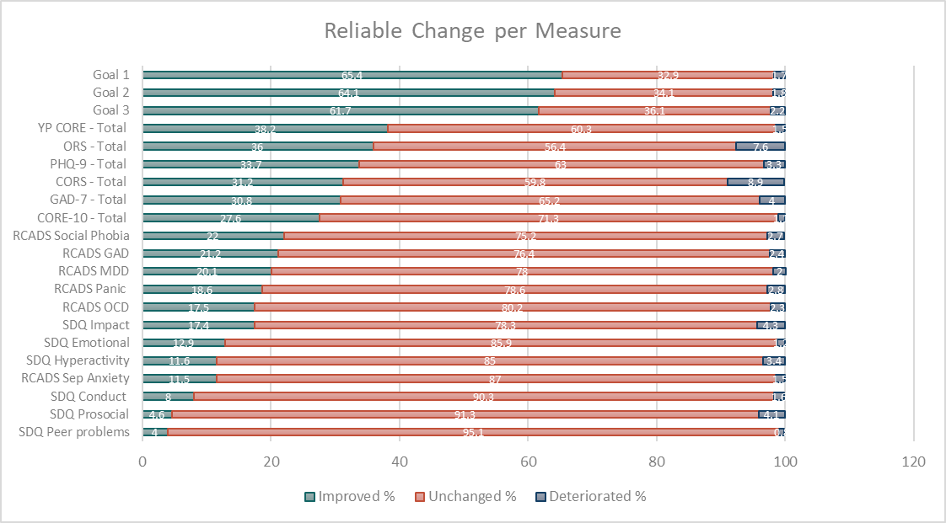
CORC Comparators
Based on our merged data-sets
A more flexible tool for members (and others) wanting to compare change in their services to that seen in other services
Allows sensitivity to different rates of improvement seen for different measurement questionnaires
Available on the members area of our website:
RCADS subscales
SDQ subscales
SDQ impact supplement
Child Outcome Rating Scale (CORS)
Outcome Rating Scale (ORS)
Clinical Outcomes in Routine Evaluation 10 (CORE-10)
Young Person’s CORE (YP-CORE)
Generalised Anxiety Disorder 7 (GAD-7)
Patient Health Questionnaire 9 (PHQ-9)
Notes:
Drawing from the data that members have shared through CORC, we have developed a set of CORC Comparators for commonly used outcome measures. These tools provide the change reported by children and young people in the CORC dataset for each measure, allowing you to compare this with your own organisation’s data. This can help you to think about whether the outcomes in your service are in line with your expectations. We used an approach that shows both how much people improve, stay the same or get worse; and how much of that improvement/deterioration is ‘reliable’ (beyond what could be explained by measurement error for that questionnaire).

Slide 11
Each comparator shows what proportion of children using that measurement questionnaire experienced change.
You can compare this with what you are seeing in your own service.

Slide 12
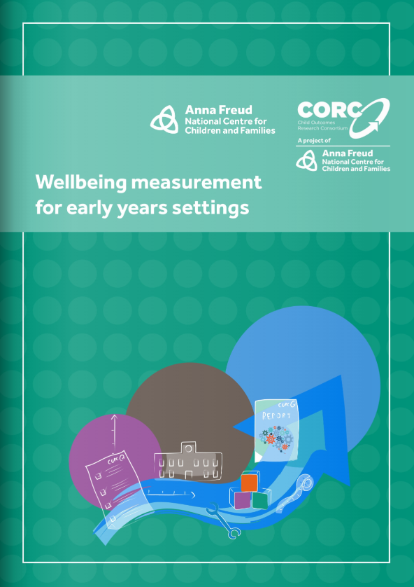
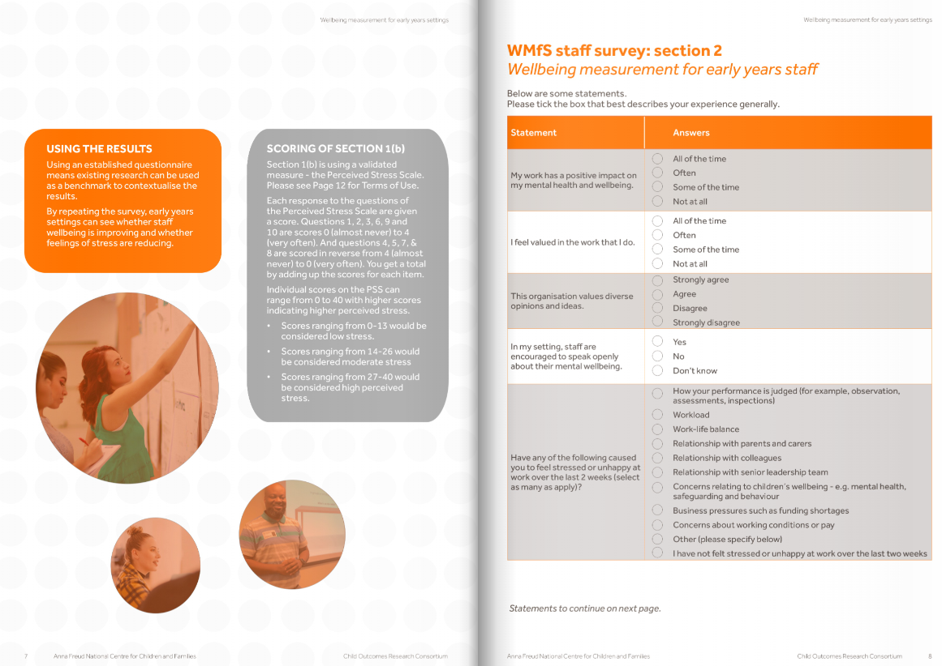
Wellbeing Measurement for Schools: Early Years
Staff survey resource
The survey draws on
validated measurement tools;
exploratory work carried out by the AfC Early Years team (a survey and more in-depth work in five areas)
Piloted and refined in summer 2022
Resource covers tips on how to use the survey, and how to interpret and use results
How staff are feeling
what is driving good and poor mental health, including how staff feel about work practices, culture, engagement and management
How supported staff feel
Wstaff feel equipped to support young children in their settings with their mental health
Notes:
5 local authorities led by the Early Years Team at AfC survey of 1,458 staff working in nurseries and pre-school setttins across England focusing on staff wellbeing (and hands-on site work…
resource for staff wellbeing measurement in early years settings
Schools have been using the Wellbeing Measurement for Schools staff survey for a few years now and find it a useful tool for understanding how staff are feeling and informing school improvement. We’re always trying to broaden the support we offer and were aware that early year’s settings didn’t have a similar survey to help them to support their staff team and wanted to do something to address this. A great thing about being part of the Anna Freud Centre is the access we have to colleagues with a vast range of experience and expertise. Developing an early year’s survey was a brilliant opportunity to partner with colleagues in the Early Years Team, led by Dr Abi Miranda, to ensure we developed something that met the specific needs of early years settings. One of our challenges was ensuring that we considered the wide range of types of settings that make up the early years sector. We needed a tool that would be as useful to a small voluntary sector nursery as it was to a large children’s centre.
he Early Years team had already carried out a large survey of 1,458 staff working in nurseries and preschool settings across England focusing on staff wellbeing. The results of this research informed the development of the tool.
Working with early years colleagues, we reviewed our schools staff survey and identified which elements that we could use and where we’d need to develop new items to ensure the survey felt relevant to the systems and structures within early years settings and spoke to their priorities and challenges identified in their research.
As a result we were excited to be able to launch the survey as a free resource earlier this month and really hope that early years settings will find it a useful tool for supporting staff wellbeing.
The pilots surveys we completed in July and we met with settings in September to talk about their experiences. We had some really positive feedback – staff were supportive that we were developing this area of our work. They felt that the survey asked the right questions and the results provided useful insight into how staff were feeling and this would support further developments. Colleagues were also able to guide us to how the survey could be refined to make it even better.
We were excited to be able to launch the survey as a free resource earlier this month and really hope that early years settings will find it a useful tool for supporting staff wellbeing. Measuring the wellbeing of staff is integral to promoting a whole-setting approach to mental hea

Slide 13
3. New learning
Title

Slide 14
1. Evaluation in school settings
Why focus on this?
There are challenges to identifying effective interventions suitable for rollout within schools and colleges:
There are many interventions, but evidence supporting these is mixed - only a few have compelling evidence of effectiveness.
The evidence we have often not accessible to schools and colleges, and often studies carried out in the US
Even for the most effective interventions, context and implementation have a huge bearing on effectiveness.
For these reasons, there has been increasing emphasis on the importance of evaluating programmes in situ
https://www.ucl.ac.uk/evidence-based-practice-unit/publications-resources/resources-professionals
Notes:
Making huge progress on understanding and measuring need using whole school surveys – levels of mental health and wellbeing and drivers of - #BeeWell, WMfS – models building out of other large scale evaluations like HeadStart and RCT studies for DfE
BUT approaches to monitoring the impact of the interventions that happen in school settings has been less well developed..
These models and examples from the - The Mercers’ Company commissioned the EBPU collaboration to support schools and colleges to understand more about the mental health and wellbeing of their students, and to assess the effect that a range of interventions have on these outcomes
Why spend time here?
While a range of school-based mental health programmes exist, there are several challenges to identifying effective interventions suitable for rollout within schools and colleges: 1. There are many different forms of intervention available but the evidence supporting these is mixed, with only a few having compelling evidence of effectiveness. 2. Little of the existing evidence is accessible to schools and colleges. 3. Evidence that does exist is often based on studies carried out in the US, in educational systems that are quite different from those in the UK. 4. Even with the most effective interventions, context and implementation have a huge bearing on effectiveness. For these reasons, there has been increasing emphasis on the importance of evaluating programmes in situ
This briefing aims to describe an approach to monitoring and evaluating children and young people’s mental health and wellbeing in schools and colleges, as a means to provide better support. The IDEA (Intervention description, Design, Evaluation implementation, Analysis and reporting) approach is described, which gives practical steps to the development of approaches to evaluating support for mental health and wellbeing delivered in educational settings. Three evaluations that have adopted this approach are also summarised.

Slide 15
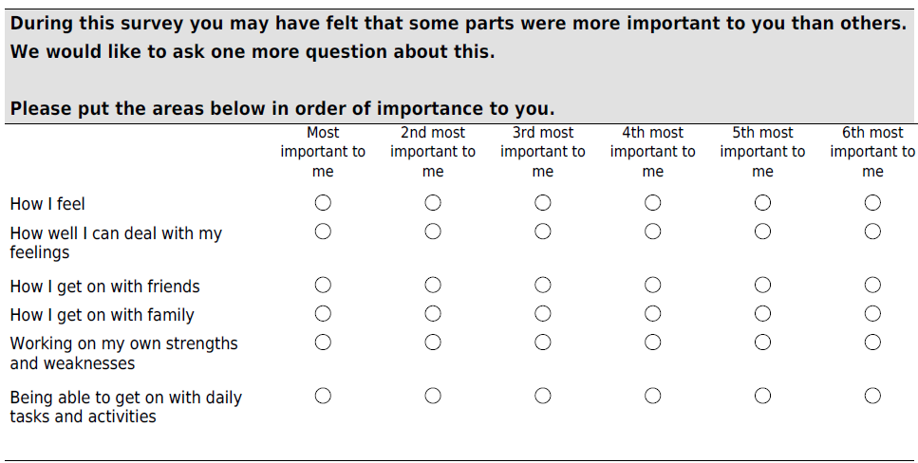
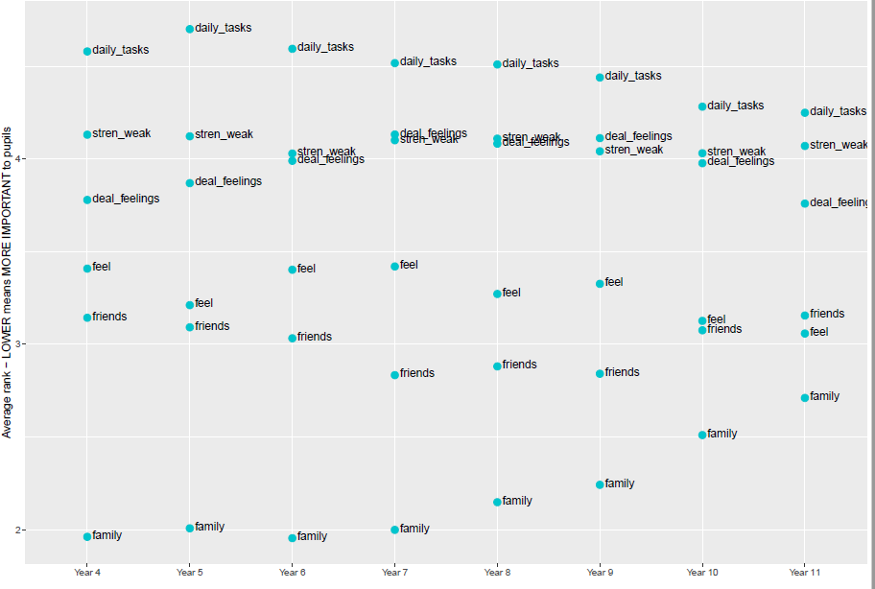
2. Measuring what matters?
Previous research suggests that shifting toward considering multiple outcome domains will help us to best reflect young people’s priorities.
This data from our Wellbeing Measurement for Schools “bonus question” reflects pupil data collected between Autumn 2020 and September 2022 and suggests:
Across years 4 to 10, relationship with family is of most importance to pupils (although this dampens with age)
Relationship with friends comes second, and ‘How I feel’ comes in third
Amongst the multiple outcome domains in Wellbeing Measurement for Schools, relationship with family is one of the lightest.
Notes:
Krause, K., Midgley, N., Edbrooke-Childs, J. et al. A comprehensive mapping of outcomes following psychotherapy for adolescent depression: The perspectives of young people, their parents and therapists. Eur Child Adolesc Psychiatry 30, 1779–1791 (2021). https://doi.org/10.1007/s00787-020-01648-8
The most frequently discussed outcome was an improvement in mood and affect (i.e., core depressive symptoms), but close to half of the participants also described changes in family functioning, coping and resilience, academic functioning, or social functioning. Coping had specific importance for adolescents, while parents and therapists showed particular interest in academic functioning. There was some variation in the outcomes discussed beyond these core themes, across stakeholder groups and treatment arms.
Of the outcomes that were frequently discussed in stakeholder narratives, only symptomatic change has been commonly reported in recent treatment studies for adolescent depression. A shift towards considering multiple outcome domains and perspectives is needed to reflect stakeholder priorities and enable more nuanced insights into change processes.
---
Attention to what treatment outcomes matter most…
YP with lived experience of depression: all four profiles prioritised improvements in mood and the ability to feel pleasure but differed in the level of importance assigned to learning coping skills, processing experiences, and the reduced interference of depression with life and identity.
Types of goals/ goal themes - intrapersonal goals, interpersonal goals and intrapersonal goals directly related to others

Slide 16
3. New models of care
2018-21 evaluation: findings
3. New models of care: Community Forensic Child and Adolescent Mental Health Services (F:CAMHS)
Containing the network’s anxiety
Lowered risk due to consistency in the network and understanding of need
Catching young people who would have fallen through the gaps
Parents/carers reported individualised care grounded in understanding and specialised support and advice
Significant improvements in mental health, wellbeing and quality of life
13 services across England commissioned in 2018, under a national service specification
Offering specialised support to young people at high risk of harm to self and others
Tier 4 highly specialist mental health services
Advice and consultation to help referrers better manage the needs of complex young people
Assessment
Occasionally, case management
Majority of reasons for referral are violence or aggression (Lane et al., 2021)
Learning has been taken forward by NHS England and NHS Improvement, as part of the Integrated Care System remit
Childs et al (2021): National evaluation of Community Forensic Child and Adolescent Mental Health Services
https://www.annafreud.org/media/16652/community-fcamhs-final-report.pdf
Notes:
In 2018, as part of the movement to improve service provision and early intervention efforts. NHS England and NHS Improvement commissioned 13 new Community Forensic Child and Adolescent Mental Health Services (F:CAMHS)
The aim to address provision for young people who are at high risk.. In multiple domains of their lives..
Young people accessing these services experience mental health difficulties, learning disabilities, and high risk behaviours and they are likely to be in contact with social care/youth justice services (Hindley, Lenuga, & White, 2017)
The challenges of addressing these multiples needs means that young people often experience multiple transitions between services and geographical displacement (Department of Health, 2009; Lader, Singleton, & Meltzer, 2000)
Provision for this particular group of young people has been found to be patchy and inconsistent. Rationale:
Provision of services for high-risk young people across services is deemed to be fragmented and lacking in co-ordination (Hindley et al., 2017)
Geographically “patchy” provision of forensic child and adolescent mental health services in the community (Peto, Dent, Griffin, & Hindley, 2015)
Improve community mental health provision and eliminate or facilitate inpatient admissions in cases where hospitalisation cannot be avoided (Future in Mind, 2015)
So FCAMHS involved a linkage of specialist commissioning and health and justice within NHS England, offering professional-profesional advice and support, and direct support to young people who have needs in multiple domains and require a cross-agency approach.
Community F:CAMHS provide support by being a central point to ‘hold‘ cases, provide specialist advice and support, and improve inter-agency communication
Between 2018-2021 we conducted an evaluation to explore whether Community F:CAMHS leads to improved understanding of needs and improved case coordination and support
Tier 4 highly specialist mental health services
Advice and consultation to help referrers better manage the needs of complex young people
Assessment and intervention can and should take place with another agency caseholding.
In rare cases, community F:CAMHS will offer case management
Findings: HONOSCA, ED5QY
Referrers reported a positive impact on the network around the child, with Community F:CAMHS containing the network's anxiety, facilitating thinking around care and risk management, promoting interagency working, and providing direct intervention where needs were not met or identified.
Referrers also said that Community F:CAMHS’ involvement resulted in a lowering of risk presented by this group of young people, both as a result of consistency in the network and an increased understanding of the young person’s risks and needs;
Parent/carers said that teams were able to better understand young people, in a way that the families had not experienced before, and that this then promoted the sense of receiving truly individualised support
parents/carers discussed the key role of the Community F:CAMHS team in helping both themselves and their child to understand the difficulties. In some cases, they discussed this as a transformative agent of change. They also discussed how a better understanding self and others is a facilitator for making effective strategic changes, for example in one’s own reactions to situations.
Staff described linked up working across agencies, which helped to catch young people they thought would have previously fallen through the gaps
Good communication was theme running throughout the different stakeholder groups we interviews (parents/carers, referrers, commissioners and young people)
NHS England and NHS Improvement has been working since 2018 to develop more integrated commissioning of specialised services with local commissioners to maximise the opportunity for joined up, high quality and equal care for patients. Through the new legislation set out in the Health and Care Act 2022, Parliament has given the NHS the opportunity to take this further by allowing Integrated Care Boards (ICBs) to take on delegated responsibility, where appropriate, for commissioning these services but within a framework of continued national accountability, national standards, national service specifications and national clinical policies determining equal access to the latest treatments and technologies. This new legislative framework presents the opportunity for specialised services and patients to fully benefit from the focus of ICBs on their local population’s health and ensure that the specialised elements of pathways are part of the integrated design and delivery of care to patients.
Specialist service within Integrated Care Systems
New legislation allowing Integrated Care Boards to focus on local population’s health
To ensure that specialist support is incorporated in design and delivery of care
Ultimate aim of joint up care

Slide 17
4. Look out for..
Title

Slide 18
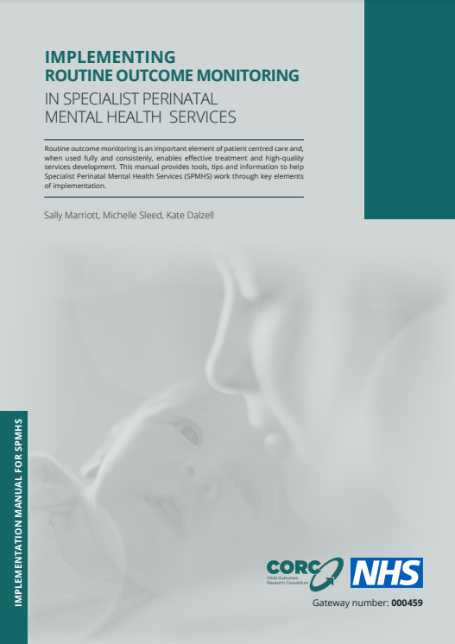
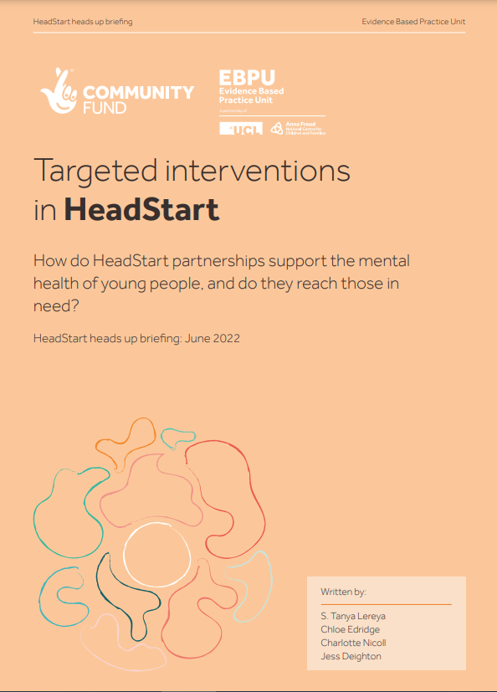
Coming up soon..
HEE e-learning: implementing routine outcome monitoring in specialist perinatal mental health services
Webinar and case studies sharing partnerships learning on user-centred approaches to outcome measurement
New trainings that apply evaluative learning from HeadStart
Developing and evaluating a cross-system mental health offer
Delivering and evaluating effective mental health and wellbeing interventions in school
CORC training modules
measuring impact
engaging young people in routine outcome monitoring
Join the CORC Network now!
www.corc.uk.net/about-corc/become-a-member/free-corc-network/
the e
the e
Notes:
Measuring impact
Engaging young people in routine outcome monitoring

Slide 19
Thanks for listening
Any questions?
CORC ADDRESS
PHONE NUMBER
EMAIL ADDRESS
TWITTER
4-8 Rodney Street,
London N1 9JH
+44 (0)20 7443 2225
corc@annafreud.org
@CORCcentral

