Slide 1
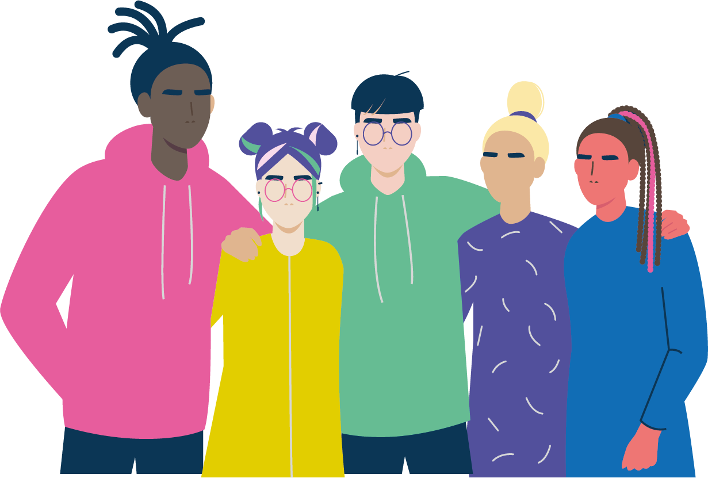
More than Voice, More than a Survey!
Elsie Whittington - Greater Manchester Combined Authority November 2022
Notes:
EW
The challenge and opportunity to improve the mental health and wellbeing of young people in England is more pressing than ever.
Peak age – this is why we’re surveying young people at secondary school.
AS a project we’re looking more at early intervention and universal offers that can support young people’s wellbeing and social connections.

Slide 2
1 in 9 children and young people experienced significant mental health difficulties prior to the pandemic (NHS Digital, 2018) This grew to 1 in 6 by summer 2020 (NHS Digital, 2020) and has stabilized since (NHS Digital, 2021) Young people's wellbeing has been in decline for the last decade (Children's Society, 2021) The peak age of onset for lifetime cases of mental health difficulties is 14.5 (Solmi et al, 2021)
Context
Notes:
EW
The challenge and opportunity to improve the mental health and wellbeing of young people in England is more pressing than ever.
Peak age – this is why we’re surveying young people at secondary school.
AS a project we’re looking more at early intervention and universal offers that can support young people’s wellbeing and social connections.

Slide 3
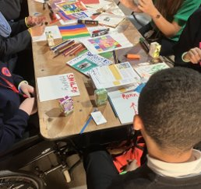
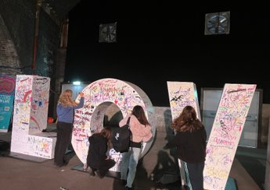
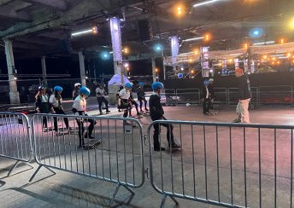
What is #BeeWell
Partnership between UoM, GMCA, AFC & GFF
Codesigned with 100 young people
38,000 young people in Years 8 and 10 across 160 secondary schools (age 12-13 and age 14-15).
Publicly available data
£600,000 direct investment into responses across Greater Manchester

Slide 4
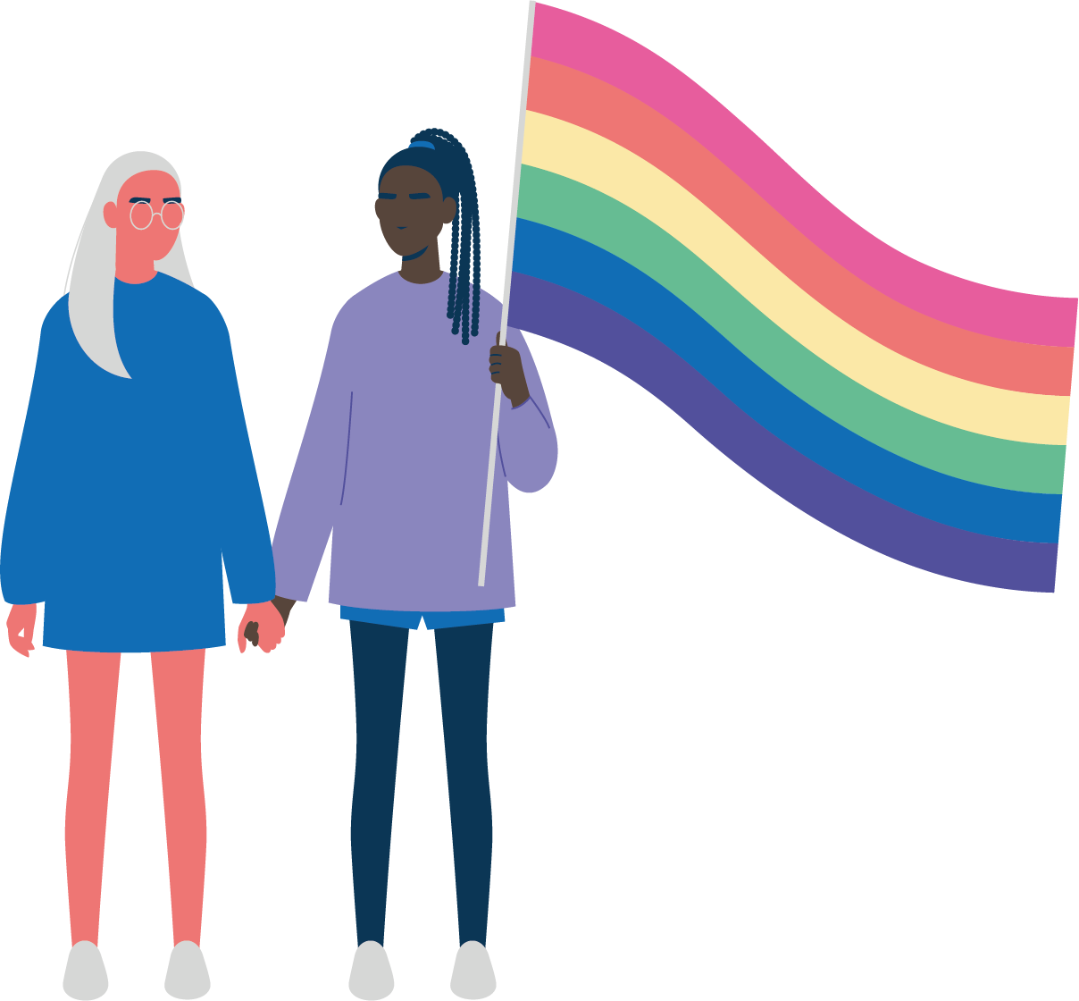
Youth Voice and Co-creation
We don't just want to be known as a survey.
We want to do action from the findings.
(YSG member)

Slide 5
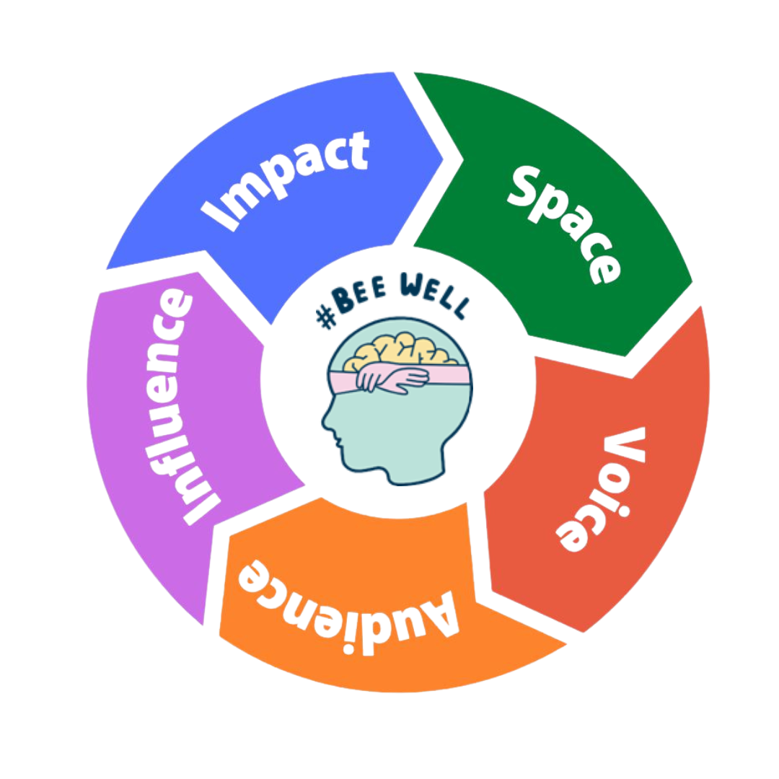
Youth Voice and Co-creation
“#BeeWell seeks to co-create an environment where young people’s wellbeing is everybody’s business. We aim to operate in ways where children, young people and adults can collaborate to shape programmes of work, research activities and engagement opportunities safely and meaningfully. We work in a youth centred way that prioritises youth participation as a key element of our work.”

Slide 6
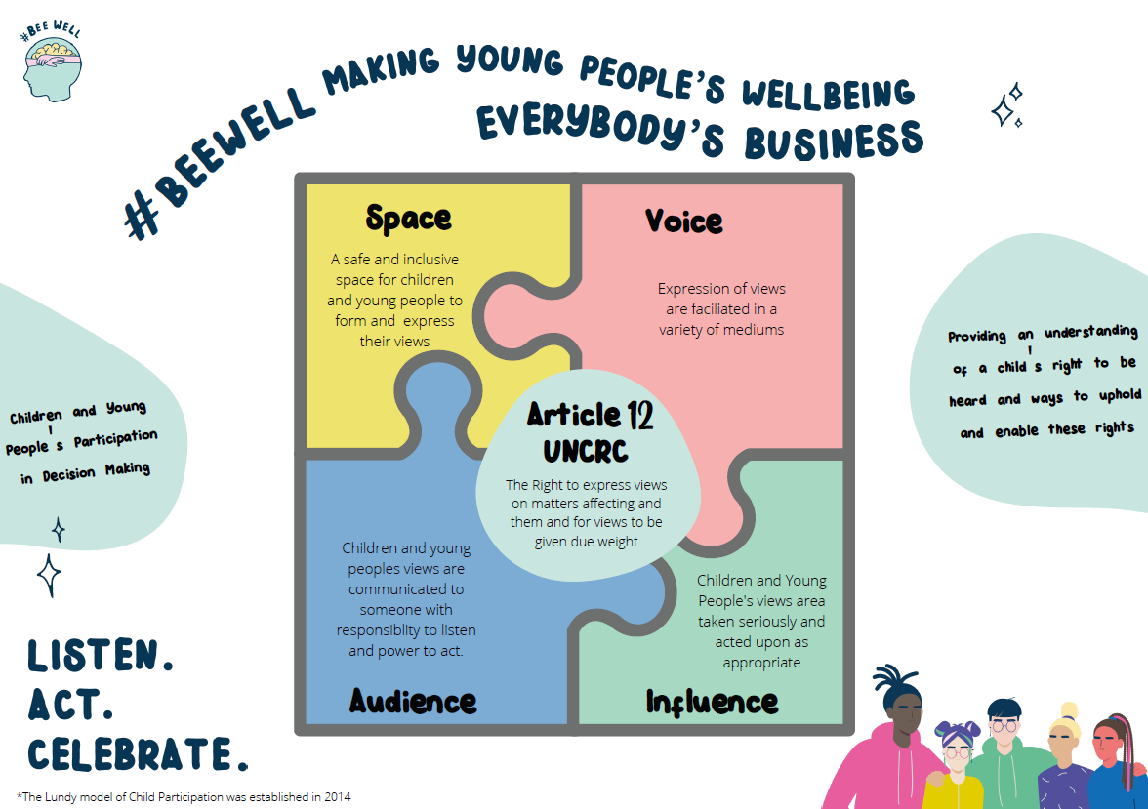

Slide 7
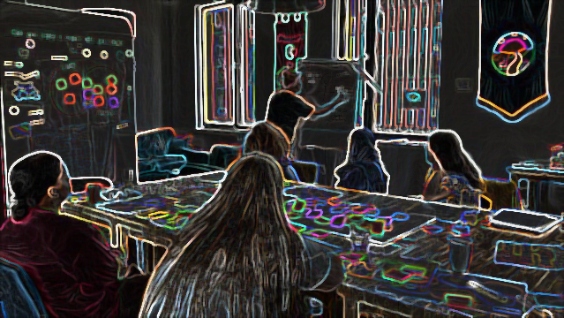
Space:
The #BW Youth Steering group
[Being in the group has] had a impact about how we think about mental health as a whole (…) it also helps us understand that we all need a balance in life and ideas on how to get that balance. (YSG member)

Slide 8
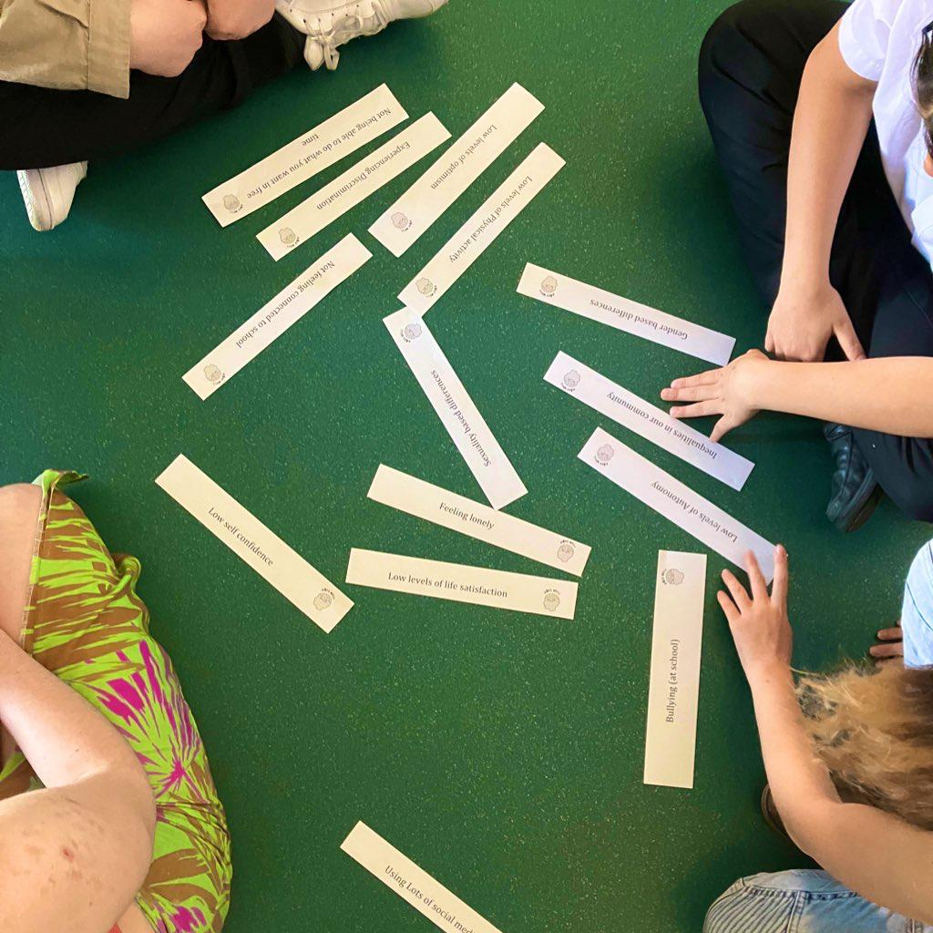
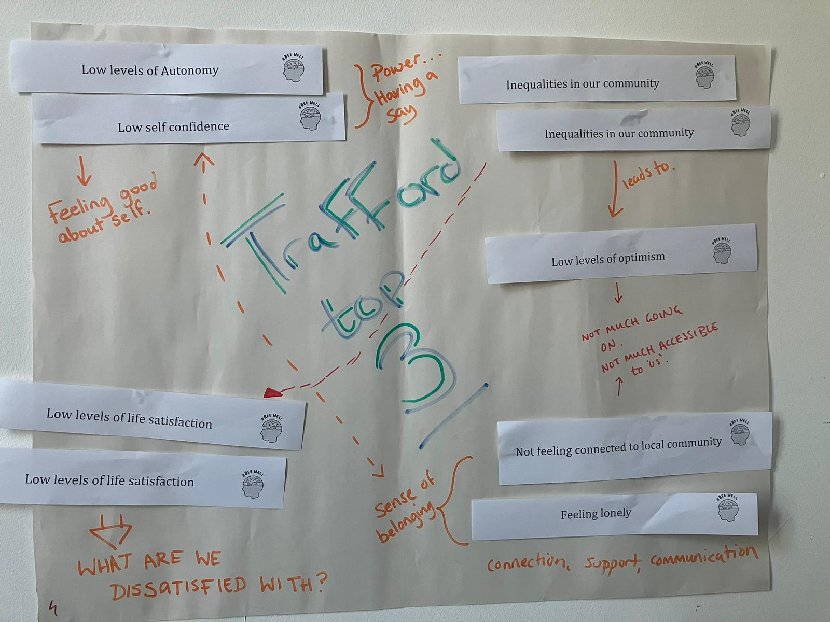
Voice/Views:
#BeeWell gives a voice to young people. We're quite young but we're giving ideas cos we can relate more to the people our ages than adults. (YSG member)
Place based Youth workshops

Slide 9
Audience:
The Politics Project – #BeeWell Digital Dialogue Sessions
Would be good to meet the adults - makes ideas harder to dismiss if you're meeting face to face (YSG member)

Slide 10
Influence
Youth Led investment: #BeeWell Champions
We want tomake it apparent that youth co-creation is effective. #BeeWell is by young people and involves us so and it's a real success.
(YSG member)

Slide 11
Impact:
#BeeWell data demonstrating the Trans and Non-binary young people have lower wellbeing
Intergenerational conversations about importance of youth participation, and visibility for MH/WB
Proud Trust (GM wide LGBTQ+ charity) have responded to this by making a case to the board to fund a trans youth voice worker for GM.
Documenting and Evaluating…
Time will tell…
Next steps…

Slide 12
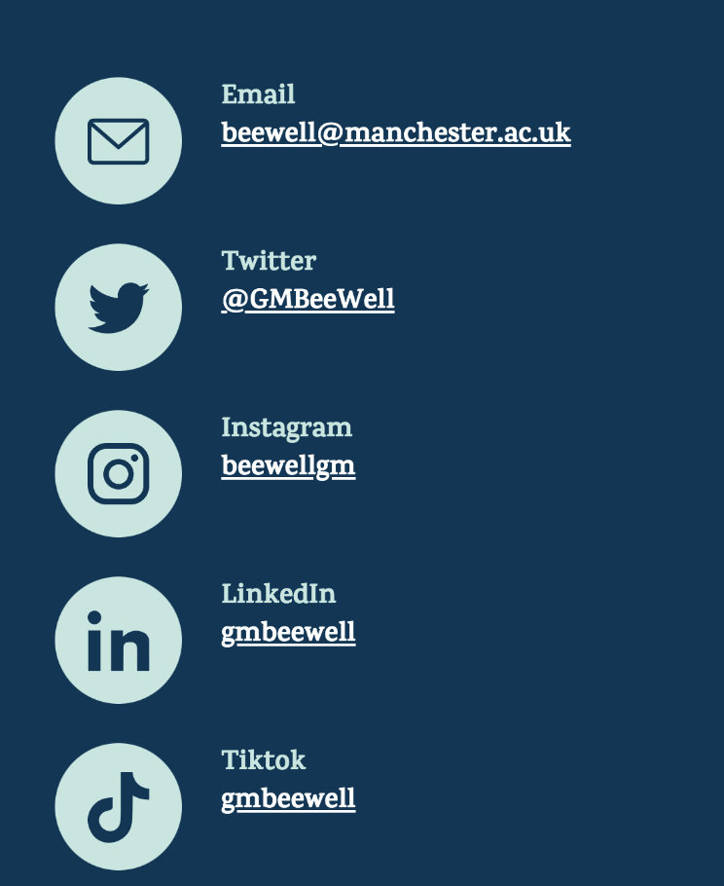
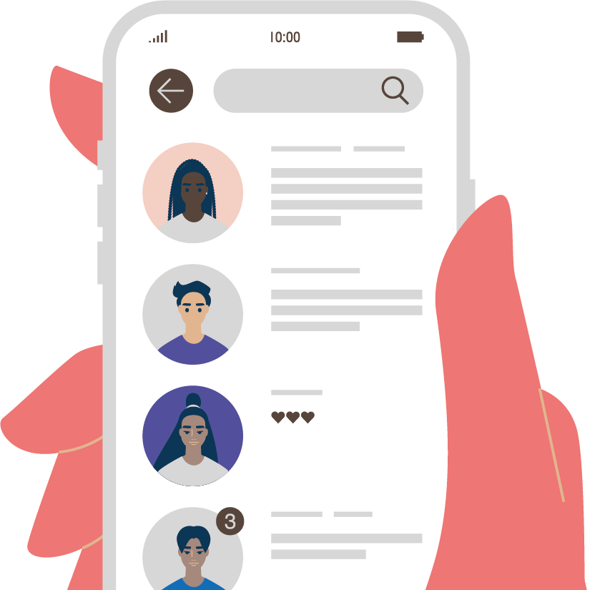
Reflections on our work and yours…
How does this work relate to policy and practice in your local area?
Which element of the Lundy Model do you think you are doing well
Which element of the Lundy Model do you think you could improve the most?

